Slide 1
You are going to continue learn how to write persuasively!
This is where you believe/ want something and you are trying to convince the other person to do it!
An example could be you trying persuade your grown up at home to buy you a McDonalds for tea? Or to buy you an ice cream after school?
Can you think of your own example?

Slide 4
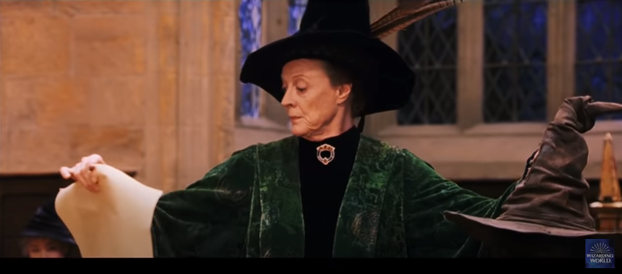
https://www.youtube.com/watch?v=z4K2F_OALPQ
Now find out which house you’re going to be in by looking at the Sorting hat powerpoint!

Slide 5
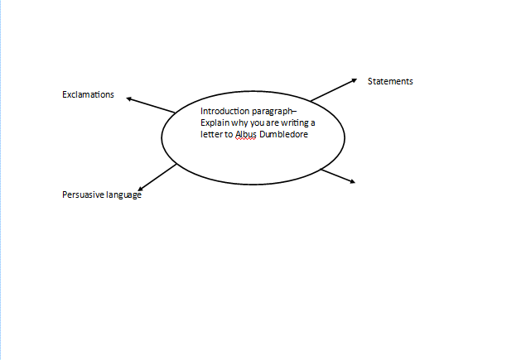
Using your ideas that you mind-mapped yesterday, please complete the planning format in the word document. Each page on the plan is a different paragraph and will need a different point.

