Slide 1
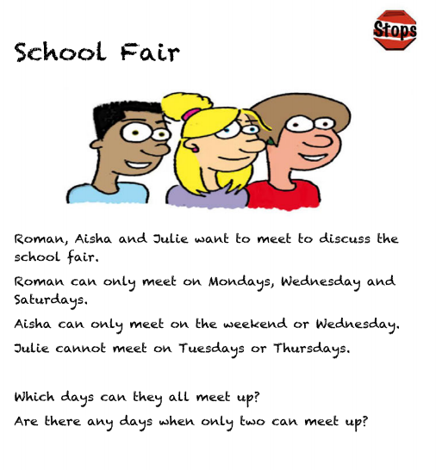
First problem…
TIP: Drawing a table will help!

Slide 2
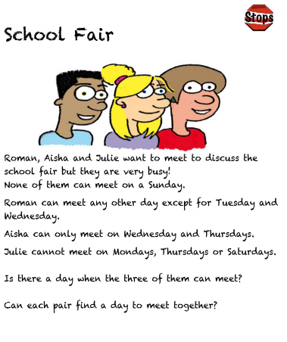
Second problem…

Slide 3
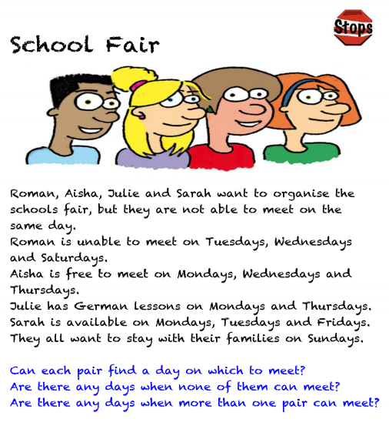
Third problem..

Slide 4
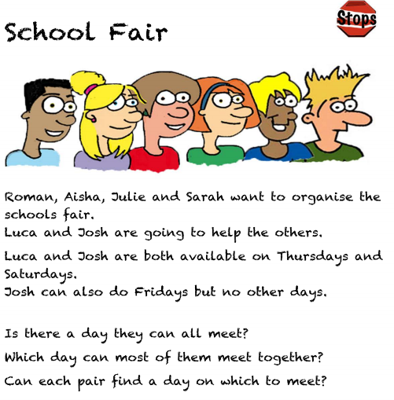
Challenge:

