Slide 1
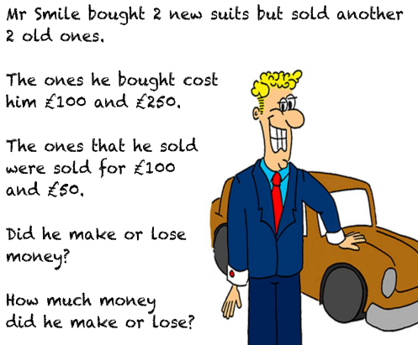
Problem Solving Day – Working Backwards
The new suits cost him:
£100 + £250 = £350
The suits he sold gained him
£100 + £50 = £150
To answer this part of the question I need to find the difference between the 2 answers
£350 - £150 = £200
Lost
£200

Slide 2
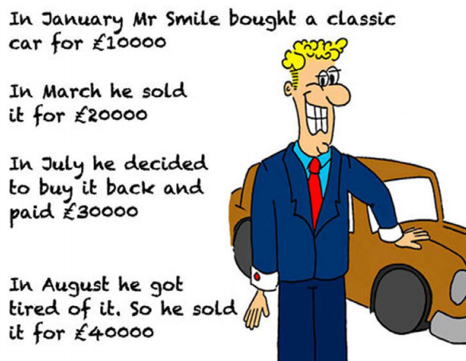
Activity 1:
TIP: To find the answer you need to take it 1 step at a time.

Slide 3
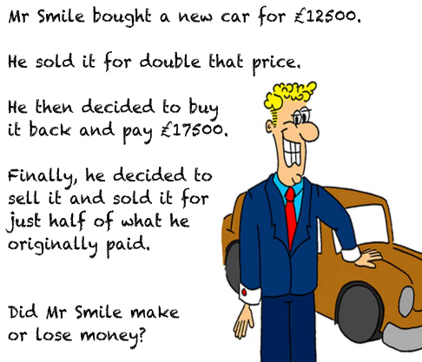
Challenge:

