Slide 1
Year 4 Measurement
I want you to check your previous work using the example to help you .
Your job today is to create a rectilinear shape that has a shape of at least 6 squares.

Slide 2
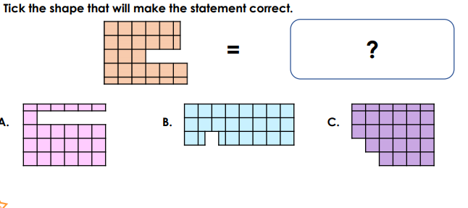
Challenge 1:
Challenge 2: TIP = remember 2 halves make 1 whole.

Slide 3
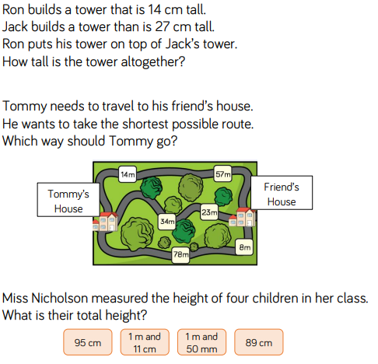
Year 3 Measurement
Today we are moving onto looking at adding lengths.
It is a simple addition and we follow the same rules just
like if we were adding 2 numbers together.
Don’t guess
Use column method if your stuck
Remember to add the unit of measure to your answer
TIP: remember if we have different units of measurements we need to convert them to the same unit before we answer the question.

Slide 4
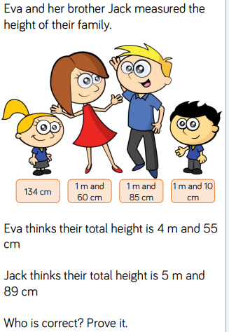
Challenge 1: Challenge 2:

