Slide 1
You are going to continue learn how to write persuasively!
This is where you believe/ want something and you are trying to convince the other person to do it!
An example could be you trying persuade your grown up at home to buy you a McDonalds for tea? Or to buy you an ice cream after school?
Can you think of your own example?

Slide 4
Task 1: You have a secret mission…
Can you think of something that you really want? Can you use persuasive phrases (previous slide) to help you get what you want? Try and persuade your grown up at home as to why they should get you want you really want! (Only something little like an ice cream-not a PS4!)

Slide 5
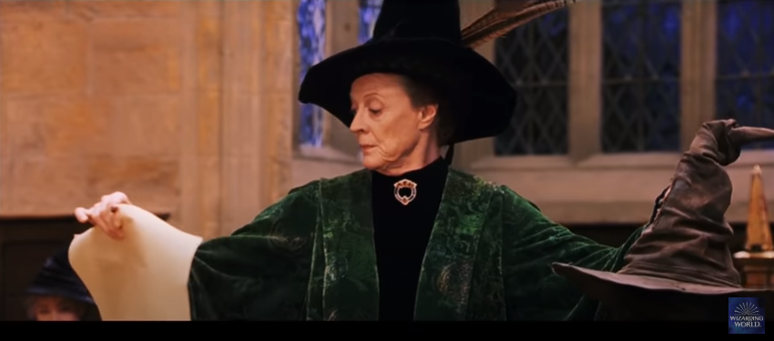
https://www.youtube.com/watch?v=z4K2F_OALPQ- Last week you were put in houses!

Slide 6
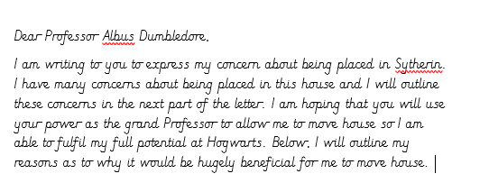
This week you are going to start writing your persuasive letter to Albus Dumbledore asking him to let you change houses! Today you are going to write the introduction. The introduction is when you outline why you are writing to the person and what you want to happen. Here is one that’s been done for you…

Slide 7
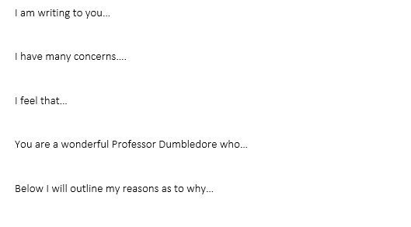
Can you write your own introduction? Here are some sentence starters to help you. Please write it in a paragraph…

