Slide 1
You are going to continue learn how to write persuasively!
This is where you believe/ want something and you are trying to convince the other person to do it!
An example could be you trying persuade your grown up at home to buy you a McDonalds for tea? Or to buy you an ice cream after school?
Can you think of your own example?

Slide 4
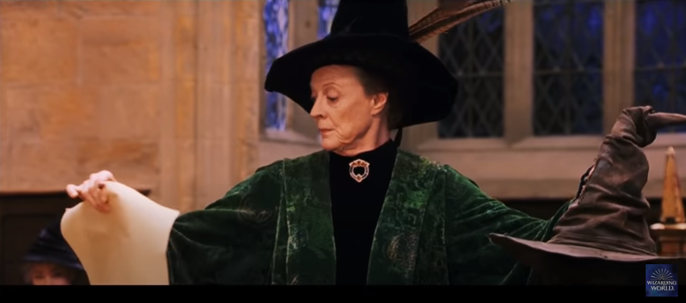
https://www.youtube.com/watch?v=z4K2F_OALPQ- Last week you were put in houses!

Slide 5
This week you are going to start writing your persuasive letter to Albus Dumbledore asking him to let you change houses! Today you are going to write the next paragraph outlining the first reason why you should move house. You need to PEE all over your work! (POINT, EVIDENCE, EXPLANATION.) Keep your point clear and concise and use persuasive language!

Slide 6
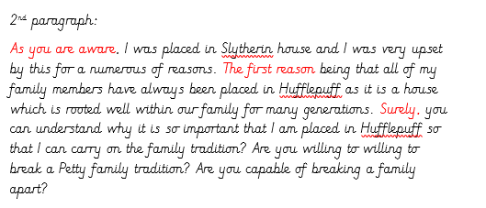
Can you write your own next paragraph? Here are some sentence starters to help you. Please write it in a paragraph…

