Slide 1
Primary Geography Quality Mark 2019/2020 Bronze application

Slide 2
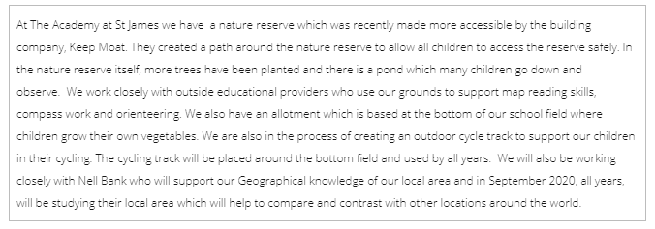
Information about our school.

Slide 3
Information about our school.

Slide 4
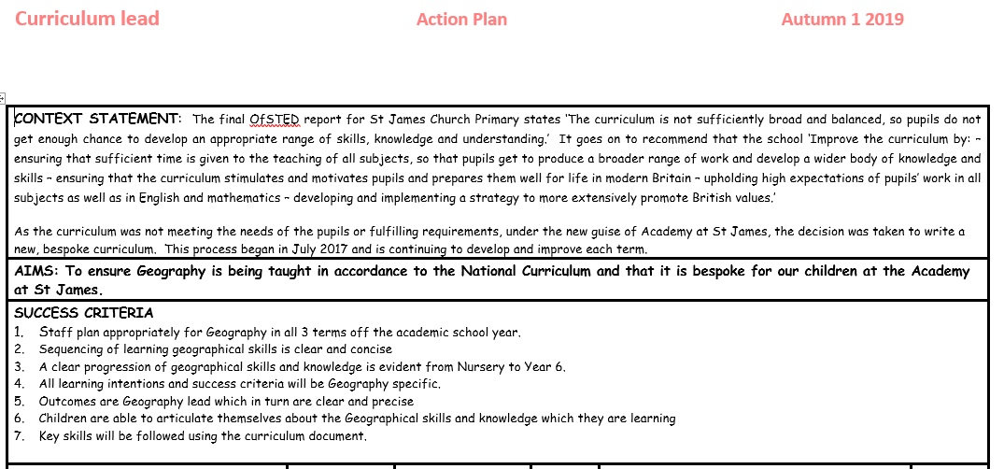
Section A- What is the quality of geography education like?
Context Slip
Criteria met: e.g. A2(i) | A1 (i)
Context: what is the evidence, what does it show and how is it hitting the key indicator? | This is an extract from the Geography action plan (appendix 1) which was written by the Geography lead alongside the Curriculum lead. It focuses on Ofsted’s recommendation following from the Inspection in 2016 (appendix 2) and Ofsted's report in 2018 (appendix 3). We have placed a huge emphasis on our curriculum as it was re-written in 2017 and is being developed now, in 2020 to ensure that high quality geography is being taught.
Why was this example chosen? | This was chosen as it highlights the journey that we have been on as a school and it shows what underpins our curriculum and geography learning at The Academy at St James.
What does it show that children know, understand and can do? | It shows what we want our children to be able to do when they are at our school and the focus and training which we have given to our staff. We want a clear progression of geography being taught and this can be seen in he further slides.

Slide 5
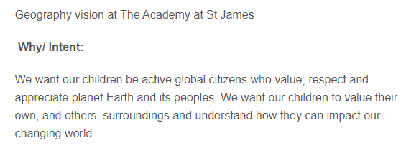
Section A- What is the quality of geography education like?
Context Slip
Criteria met: e.g. A2(i) | A1 (i)
Context: what is the evidence, what does it show and how is it hitting the key indicator? | It shows our clear and concise intent which underpins every lesson, every outcome, every resource and every educational visit which we go to promote our love of Geography learning! (see appendix 4)
Why was this example chosen? | This example was chosen as it shows how intent to our whole geography curriculum and why geography is fundamental to our school and how to underpins our learning in other key subjects.
What does it show that children know, understand and can do? | It is our intent to the whole of the geography curriculum which goes beyond the classroom walls. It is our end goal and something which children understand and strive to in every year.
This is our Geography intent at The Academy at St James. We kept it simple and concise as this is simply why we teach geography at our school. It is fundamental that our children understand the impact which they can have and develop into conscious global citizens who are aware the impact which they can have.

Slide 6
Section A- What is the quality of geography education like?
https://academystjames.com/geography/
Context Slip
Criteria met: e.g. A2(i) | A1 (i)
Context: what is the evidence, what does it show and how is it hitting the key indicator? | This is the first 3 aims taken from our school Geography policy, which can be found using the link provided, it reinforces our intent for the whole school and actively encourages teachers to ensure their lessons are planned in accordance to these aims. (see appendix 5)
Why was this example chosen? | This example was chosen as it shows how intent to our whole geography curriculum and why geography is fundamental to our school and how to underpins our learning in other key subjects.
What does it show that children know, understand and can do? | It is our intent to the whole of the geography curriculum which goes beyond the classroom walls. It is our end goal and something which children understand and strive to in every year.
This is an extract taken from our Geography policy, the policy was shared and created with teachers to ensure that all staff whether being teaching or support staff know the importance of geography and how it can underpin other subjects using cross-curricular links.

Slide 7
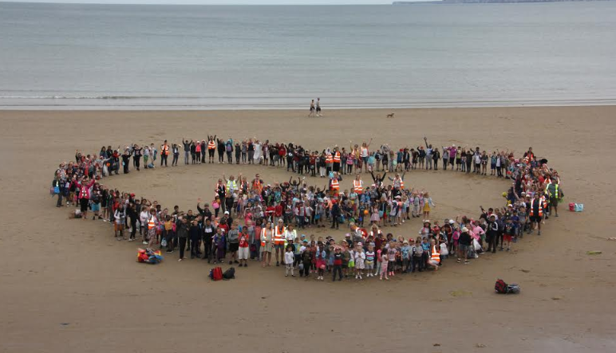
Section A- What is the quality of geography education like?
Context Slip
Criteria met: e.g. A2(i) | A1 (i)
Context: what is the evidence, what does it show and how is it hitting the key indicator? | These are the next 3 aims which have been taken from the geography policy. Focussing on providing opportunities for our child, is fundamental to our school and everything in which we do. This can also be supported by our whole trip to Filey, there are pictures to support.
Why was this example chosen? | This example has been chosen as it shows more in depth the importance of visits and opportunities for our children to provide them all with experience which they normally would not be provided with at home. This will shown later on in the presentation.
What does it show that children know, understand and can do? | It is our intent to the whole of the geography curriculum which goes beyond the classroom walls. It is our end goal and something which children understand and strive to in every year.
**INSERT PICTURE OF FILEY**

Slide 8
Section A- What is the quality of geography education like?
Context Slip
Criteria met: e.g. A2(i) | A1 (i)
Context: what is the evidence, what does it show and how is it hitting the key indicator? | This has been included as it’s important to highlight where our geography intent has been developed and derived from which is from our overall curriculum intent. Our geography curriculum is innovative and personalised and has changed, adapted over the years to suit different cohorts of children.
Why was this example chosen? | This example has been chosen as it shows our whole school approach to the curriculum, which was also written with staff, it is important to know that this curriculum was re-written 2 years ago when the school was put into special measures and now we are able to focus on embedding non-core subjects (geography) into our curriculum.
What does it show that children know, understand and can do? | This has been shared with parents, children and visitors and it is clearly visible our aim for our curriculum when you visit our school, to be purposeful and meaningful- which is fundamental to our geography curriculum.

Slide 9
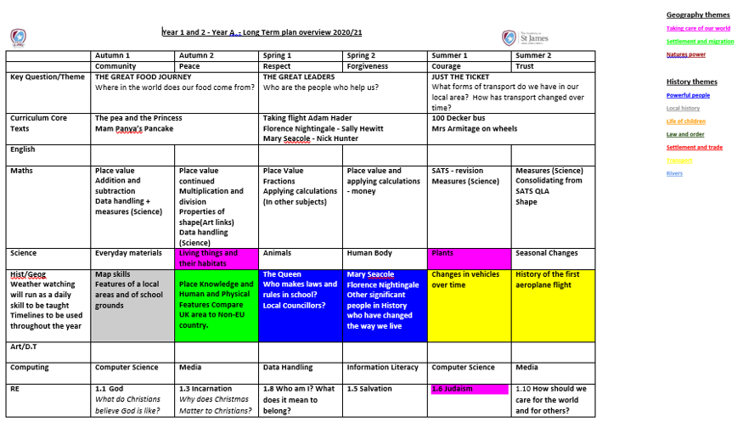
Section A- What is the quality of geography education like?
Context Slip
Criteria met: e.g. A2(i) | A1 (ii) and A1 (iv) and A3 (iii) and D (i) and D (iii)
Context: what is the evidence, what does it show and how is it hitting the key indicator? | This is Year 1 and Year 2’s long term plan which has been created by the curriculum lead, subject leaders and teachers. It shows our well planned and coherent geography curriculum as it shows our themes of learning which are taught and developed throughout the 2 years. (see appendix 6)
Why was this example chosen? | This was chosen as it shows our ambitious curriculum which focuses on local areas and in particular our school grounds, eg nature reserve.
What does it show that children know, understand and can do? | It shows what we want our children to be able to know when they leave KS1 as it has been well planned and is very ambitious which is supported by cross-curriculur links!

Slide 10
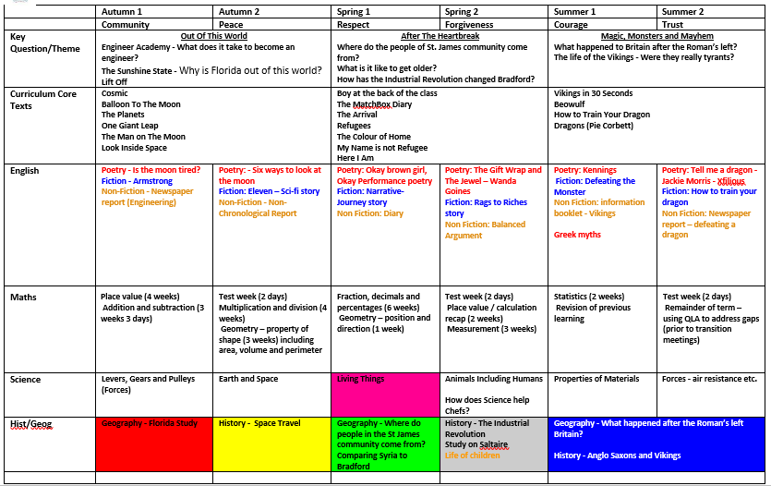
Section A- What is the quality of geography education like?
Context Slip
Criteria met: e.g. A2(i) | A1 (ii) and A1 (iv) and A3 (iii) and D (i) and D (iii)
Context: what is the evidence, what does it show and how is it hitting the key indicator? | This is Year 5’s long term plan which has been created by the curriculum lead, subject leaders and teachers. It shows our well planned and coherent geography curriculum as it shows our themes of learning which are taught and developed throughout the year. (see appendix 7)
Why was this example chosen? | This was chosen as it shows how our Geography curriculum is developed upon as in the previous slide, Yr1/2 focus on the local area and Year 5 focus on the local area but whilst comparing to Syria which links to migration.
What does it show that children know, understand and can do? | It shows what we want our children to be able to know when they leave KS2 as it has been well planned and is very ambitious, which is supported by cross-curricular links!
Long term plan-Year 5

Slide 11
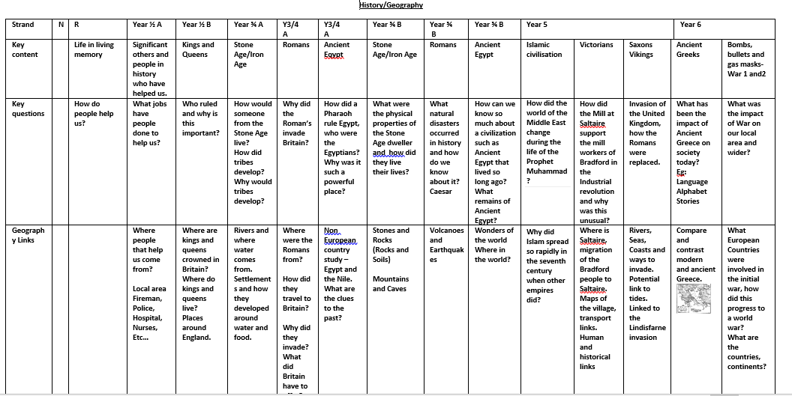
Section A- What is the quality of geography education like?
Context Slip
Criteria met: e.g. A2(i) | A1 (ii) and A1 (iv) and A3 (iii) and D (i) and D (iii)
Context: what is the evidence, what does it show and how is it hitting the key indicator? | This is our whole school outline of our curriculum from Reception to Year 6. It shows the key questions which are the focus of learning for the unit of work. (see appendix 8)
Why was this example chosen? | This example was chosen as it shows how learning is built on with our spiral curriculum and how we are preparing children for their next stage of education.
What does it show that children know, understand and can do? | It shows that we have a spiral approach to our curriculum and one which allows prior knowledge to be built on and developed. We constantly recap over our local area whilst comparing and contrasting to another place of interest which will support the next stage in their education.

Slide 12
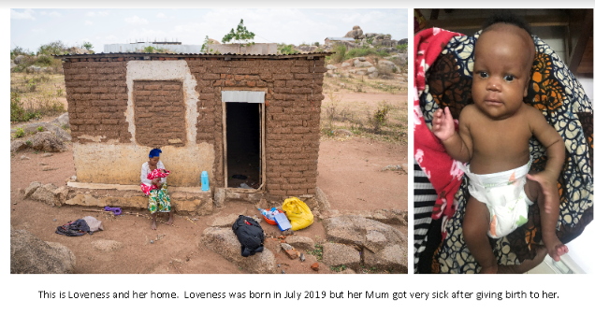
Section A- What is the quality of geography education like?
Context Slip
Criteria met: e.g. A2(i) | A1 (ii) and A3 (iii)
Context: what is the evidence, what does it show and how is it hitting the key indicator? | This first picture is a slide taken from the assembly which Mr Tolson delivered to the whole school. Mr Tolson taught in Tanzania for many years and this charity, Forever Angels, was created by his friend. It is a charity which provides support for orphan babies and children. As a school, we raised over £750 due to staff walking and running outside of school.
Why was this example chosen? | This example was chosen as it shows that geography supports meaningful community events which make a real difference to other people’ s lives who are less fortunate than ourselves.
What does it show that children know, understand and can do? | Its shows that children were able to compare and contrast their lives to other children in another continent. It provides children with a meaningful understanding of the world around them whilst discussing noticeable differences between their lives and the children who need support and safety.
https://trek2tanzania.raisely.com/t/academystjames

Slide 13
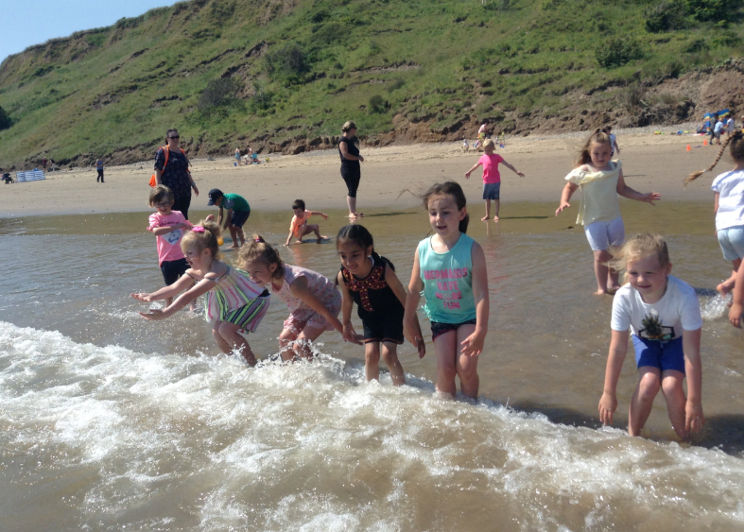
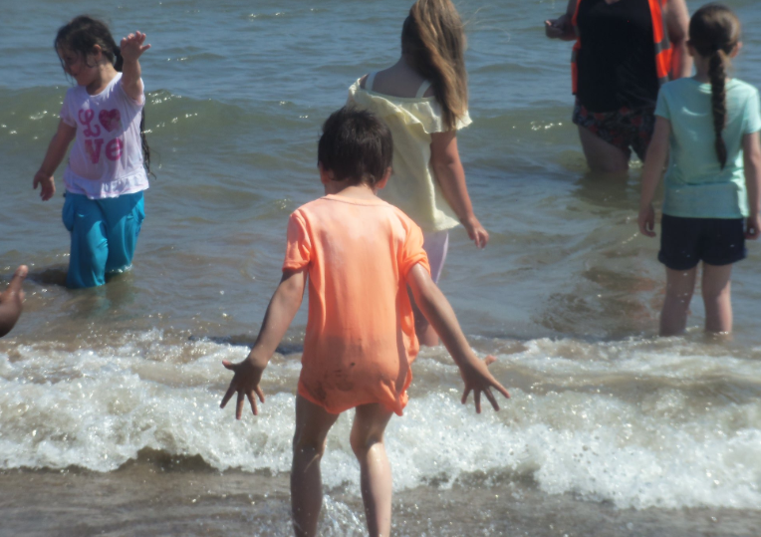
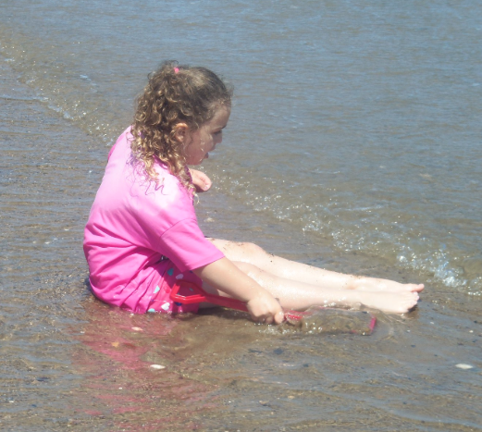
Section A- What is the quality of geography education like?
Context Slip
Criteria met: e.g. A2(i) | A1 (iii)
Context: what is the evidence, what does it show and how is it hitting the key indicator? | These are pictures from our whole school trip to Filey. It was when 352 children went to the seaside for the whole day. For many of our children, it was the first time that they had ever been to the seaside or even been on a beach.
Why was this example chosen? | This was chosen as it shows the emphasis that we put on community events which underpin our geography curriculum. Allowing children to explore the seaside, see a coastline and experience a seaside village.
What does it show that children know, understand and can do? | It shows the experiences that we provide for All of our children. It shows that children were able to come together as a community and value Filey as not only a community event but an educational visit of the seaside!

Slide 14
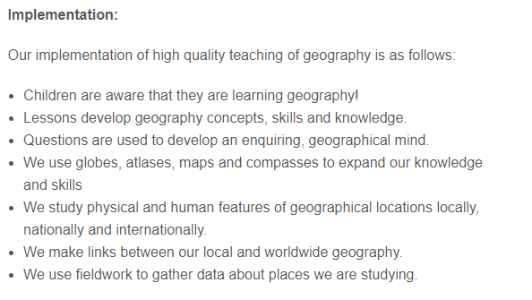
Section A- What is the quality of geography education like?
Context Slip
Criteria met: e.g. A2(i) | A2 (i)
Context: what is the evidence, what does it show and how is it hitting the key indicator? | This is our implentation which was created by the curriculum lead, geography lead and curriculum advisor, Claire Holt. It is simple and precise, for example the first point where we want children to know that they are learning Geography!
Why was this example chosen? | This was chosen as it shows the work which leaders have had to do to ensure that teachers are teaching geography! Using lessons which develop skills and knowledge and use a wide range of resources to support all children in their learning. It is essential that is how our geography curriculum is delivered to meet the needs all of all pupils.
What does it show that children know, understand and can do? | It shows what we want our children to understand and what we want them to be able to do during and after they leave The Academy at St James. It is our implantation of high quality geography and how it can support teachers when teaching geography.

Slide 15
Section A- What is the quality of geography education like?
Context Slip
Criteria met: e.g. A2(i) | A2 (i)
Context: what is the evidence, what does it show and how is it hitting the key indicator? | This is an extract taken from our Medium Term plans. This is taken from Year1 and 2 on cycle A. Our medium term plans have been planned by the year group teachers, with support from Claire Holt and our curriculum lead. The geography lead supports planning for the geography section.
Why was this example chosen? | This example was chosen as it shows that we plan to the National Curriculum and the key questions which we start our geography unit of learning.
What does it show that children know, understand and can do? | It shows that when the children are in Year ½ we focus on the local area so they are able to understand the area which they live in by using 4 compass points to support their understanding of the school.

Slide 16
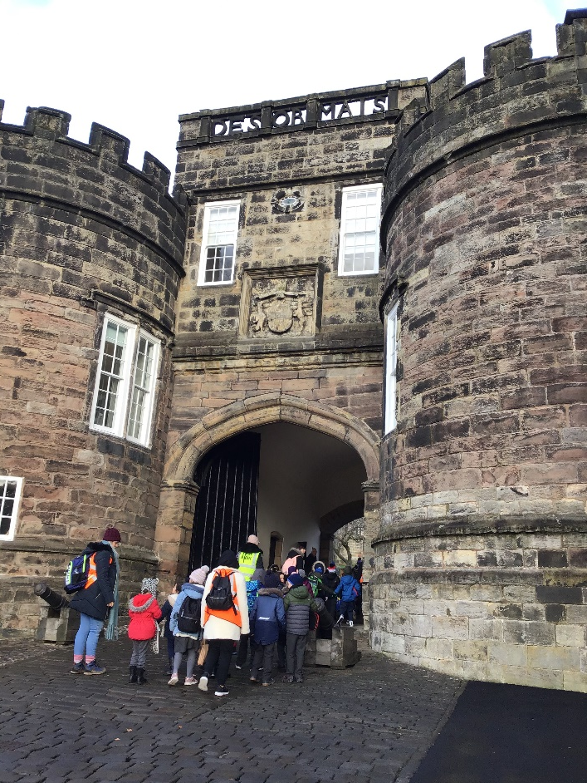
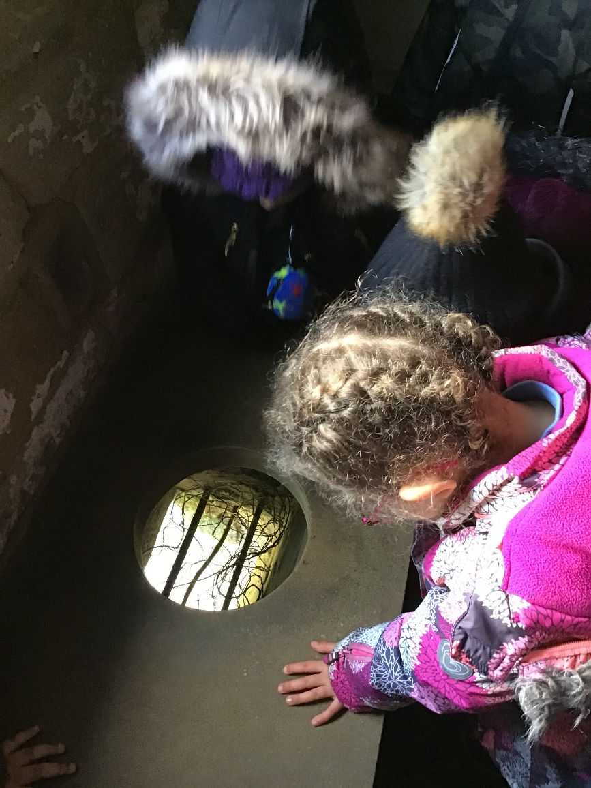
Section A- What is the quality of geography education like?
Context Slip
Criteria met: e.g. A2(i) | A2 (i)
Context: what is the evidence, what does it show and how is it hitting the key indicator? | This is when Year 1 and Year 2 went to Skipton Castle, which linked to their topic of learning about Queens and Kings.
Why was this example chosen? | This has been chosen as it shows the different ways we deliver our Geography curriculum. We believe in ‘hands on experiences’ where every child is able to experience geography in every day life. For many of our children, this was the first time they had been to a castle. They learnt where Skipton was in relation to our school using the 4 compass points.
What does it show that children know, understand and can do? | It shows that children having real life experiences which will enhance their own geographical knowledge. Being able to link history and geography together and understanding the importance of the subjects.

Slide 17
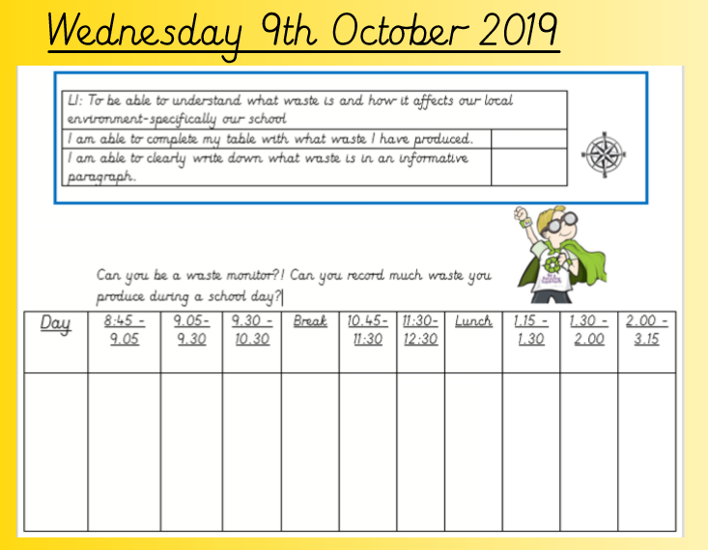
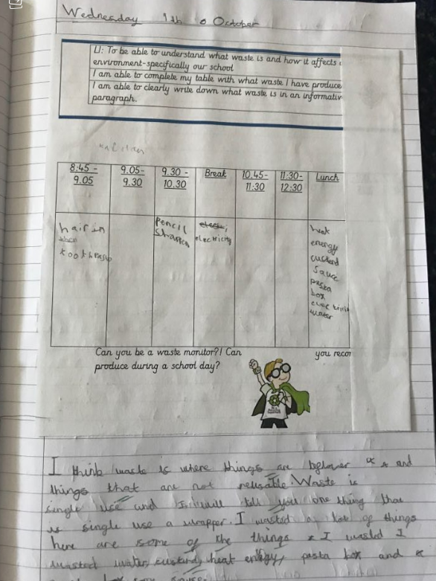
Section A- What is the quality of geography education like?
Context Slip
Criteria met: e.g. A2(i) | A2 (ii) and A2 (iii) and C (ii)
Context: what is the evidence, what does it show and how is it hitting the key indicator? | This is taken from Year 3 and 4 and this is when they were learning about ‘Save our world’. This is where they started of by learning about the local area of Allerton. The table is where children had to record data of how much waste they individually wasted throughout the day.
Why was this example chosen? | This example was chosen as it shows that geography in our school is purposeful and meaningful to our wilder environment. It is more than map reading and links back to our vision of where want our children to understand the impact which they are having on our environment.
What does it show that children know, understand and can do? | It shows that children are able to record data and understand the impact which they have on our environment. Children were really aware of any rubbish which they produced and this led to a wider discussion of rubbish in the local area.

Slide 18
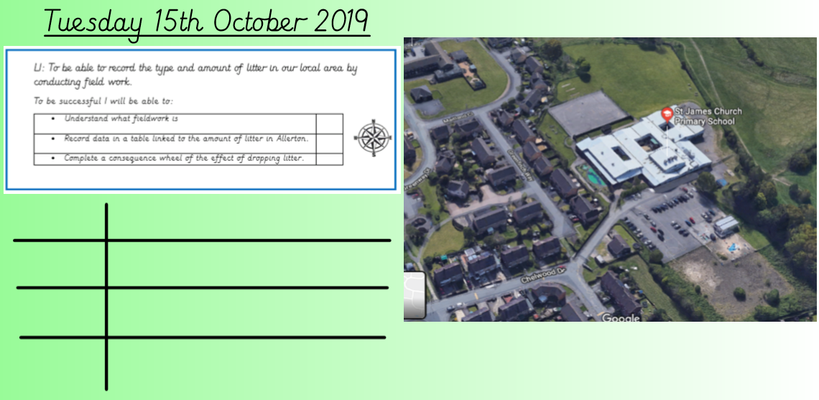
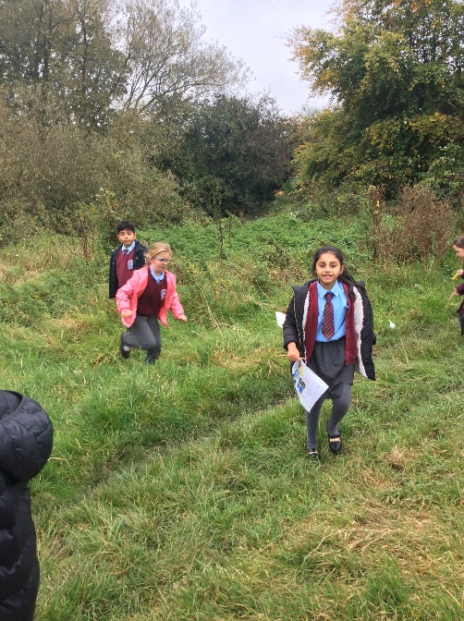
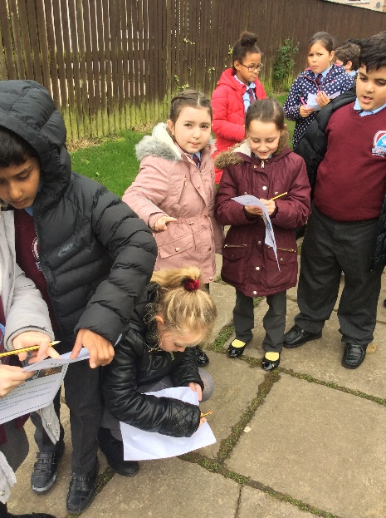
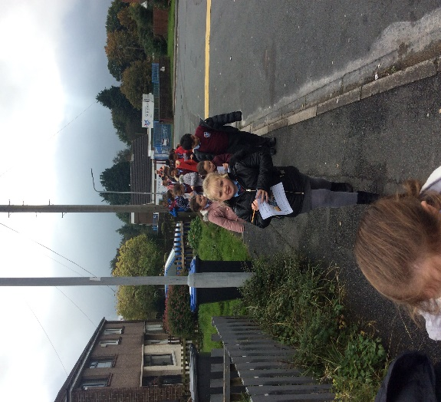
Section A- What is the quality of geography education like?
Context Slip
Criteria met: e.g. A2(i) | A2 (ii) and A2 (iii) and A2 (iv) and B (ii) and C (ii)
Context: what is the evidence, what does it show and how is it hitting the key indicator? | This is when Year 3 and 4 mapped their route from our school to our local shop and down to the local Beck. This is where the children recorded how much waste was on the road, by the shop and by the Beck.
Why was this example chosen? | This example was chosen as it shows that children were conducting fieldwork whilst collecting their own evidence of the waste which was being thrown on the floor around our school.
What does it show that children know, understand and can do? | It developed children’s understanding of Allerton through the work of map reading but also developed their understanding of the impact which they are having on their local environment an they decided they wanted to make a change!

Slide 19
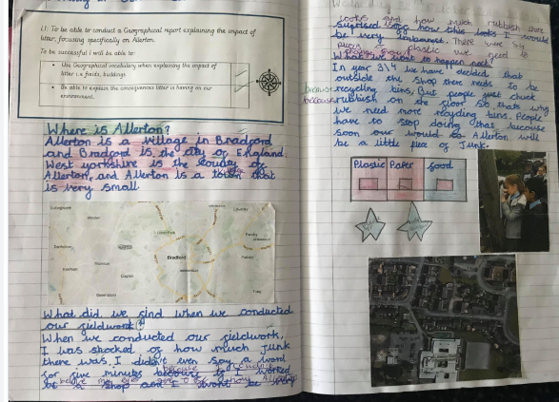
Section A- What is the quality of geography education like?
Context Slip
Criteria met: e.g. A2(i) | A2 (ii) and A2 (iii) and A2 (iV) and B (ii) and C (i) and C (ii)
Context: what is the evidence, what does it show and how is it hitting the key indicator? | This is when Year 3 and 4 wrote up their findings in a report format. They were able to display it in any way which they wanted to! They highlighted Allerton on the map (they had several to choose from and chose the one which they wanted) and wrote where it was. They then wrote what they found on their walk.
Why was this example chosen? | This example was chosen as it shows a child’s work in Year 3 explaining what she found when she was conducting her fieldwork and how now she wants recycling bins outside the local shop due to the amount of waste which was found on the floor.
What does it show that children know, understand and can do? | It developed children’s understanding of Allerton through the work of map reading but also developed their understanding of the impact which they are having on their local environment an they decided they wanted to make a change!

Slide 20
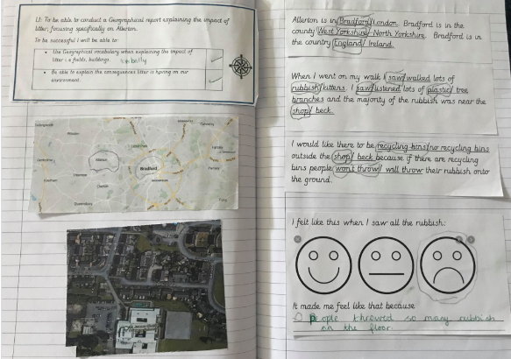
Section A- What is the quality of geography education like?
Context Slip
Criteria met: e.g. A2(i) | A2 (ii) and A2 (iii) and A2 (IV) and B (ii) and C (i) and C (ii)
Context: what is the evidence, what does it show and how is it hitting the key indicator? | This is a child in Year 3/4 who requires a 1:1 due to have a range of learning difficulties which impacts his learning.
Why was this example chosen? | This example was chosen as it shows that the geography curriculum is delivered to meet the needs of all pupils. As on the previous slide, that work was produced by an ARE child who was able to work independently. This piece of work was also done independently whilst challenging his geography knowledge. As he was asked to choose between Bradford and London and he was able to choose the correct city.
What does it show that children know, understand and can do? | It shows that he was able to access the same geography as his peers as it was tailored to his needs. He was able to find Bradford and Allerton on the map and also highlight our school on another map.

Slide 21
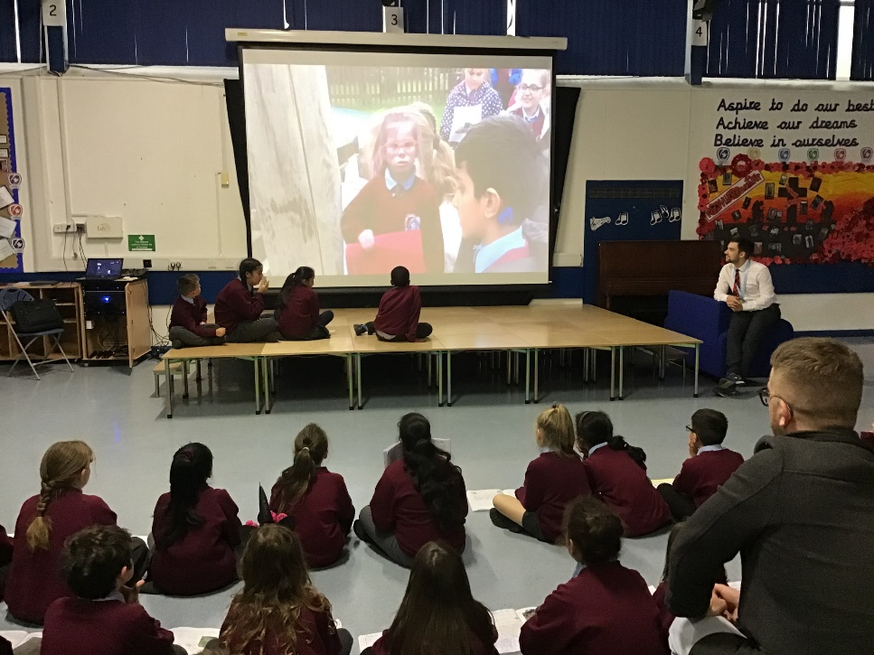
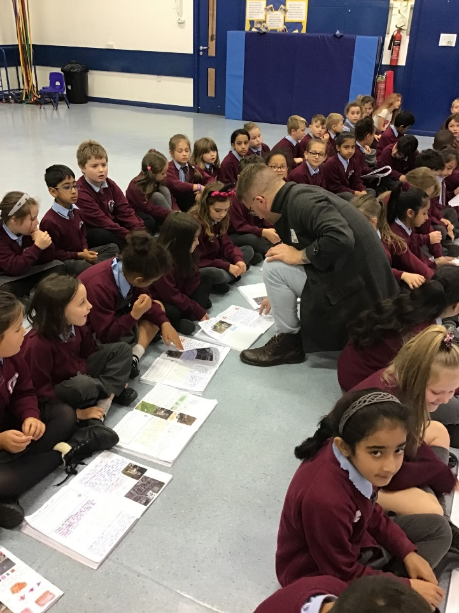
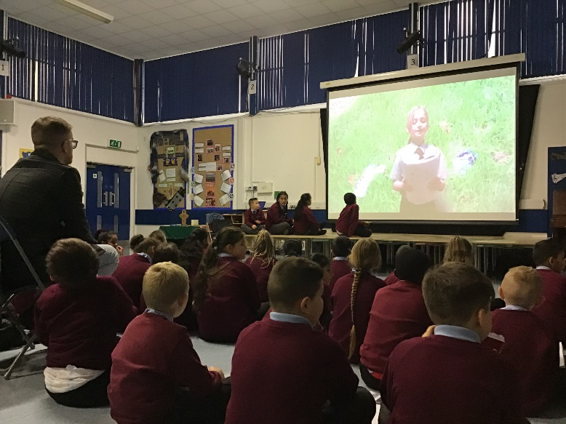
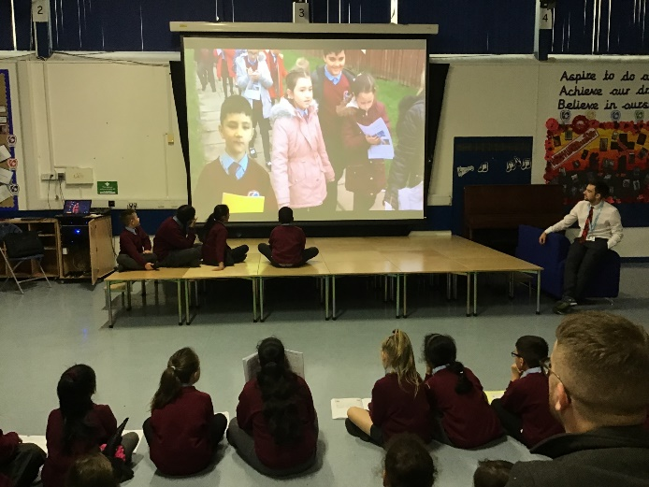
Section A- What is the quality of geography education like?
Click link to see the video which was sent to
Councillor Richard Dunbar
Context Slip
Criteria met: e.g. A2(i) | A2 (ii) and A2 (iv) and B (ii) and C (i) and C (ii)
Context: what is the evidence, what does it show and how is it hitting the key indicator? | This is where children wrote up their findings in a report format and they filmed it using green screen. Councillor Richard Dunbar was invited to our school as we were campaigning for recycling bins outside of our local shop to stop littering.
Why was this example chosen? | This example has been chosen as it shows the cross curricular links which are used within our geography lessons such as English, drama and ICT. Children were able to film and act how they deemed appropriate. They were very proud of their geographical reports!
What does it show that children know, understand and can do? | It shows that children were aware that they were learning geography (our main intent)/ It shows how our geography is delivered to meet the needs of all pupils as all children were able to conduct fieldwork, write a report and deliver their findings.

Slide 22
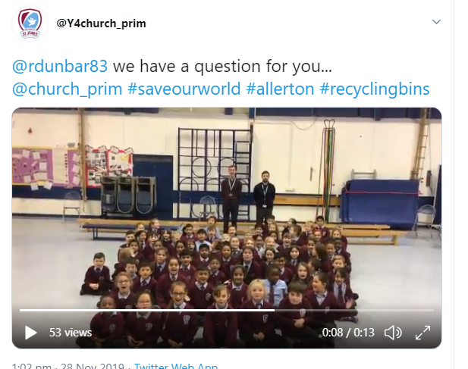
Section A- What is the quality of geography education like?
https://twitter.com/Y4church_prim/status/1200037366775324673
Context Slip
Criteria met: e.g. A2(i) | A2 (ii) and A2 (iv)
Context: what is the evidence, what does it show and how is it hitting the key indicator? | This is the video which we sent to Councillor Richard Dunbar regarding our bins.
Why was this example chosen? | This example was chosen to show that our geography lessons are embedded and intertwined in all our lessons and even when sending a video, it highlights the importance of geography as children had fought for the recycling bins and we wanted to make sure the children got them!
What does it show that children know, understand and can do? | It shows that the children see geography as an important lesson not only in the classroom but for life and it goes beyond map reading and recognising symbols (albeit important) but our geography lessons are important and meaningful.

Slide 23
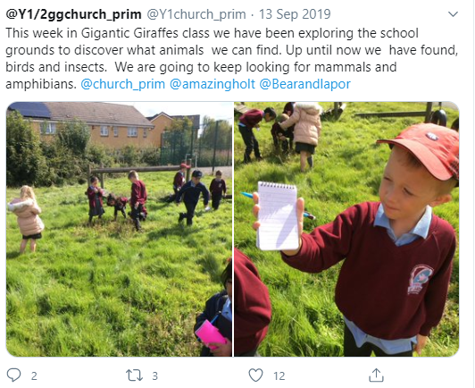
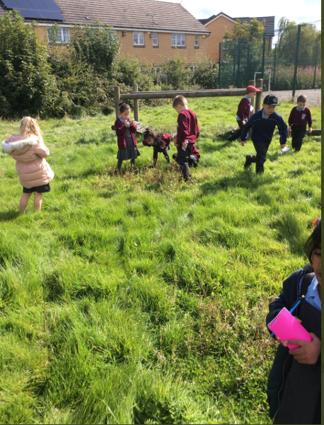
Section A- What is the quality of geography education like?
Context Slip
Criteria met: e.g. A2(i) | A3 (i) and B (i)
Context: what is the evidence, what does it show and how is it hitting the key indicator? | This is a tweet which our Year 1/ 2 team tweeted about exploring our nature reserve.
Why was this example chosen? | This example was chosen as it shows that children were able to explore our grounds with access to the nature reserve. It also shows our cross-curricular links as they were learning about mini-beasts.
What does it show that children know, understand and can do? | It shows that children were able to make sense of their natural environment and make links to their local environment.

Slide 24
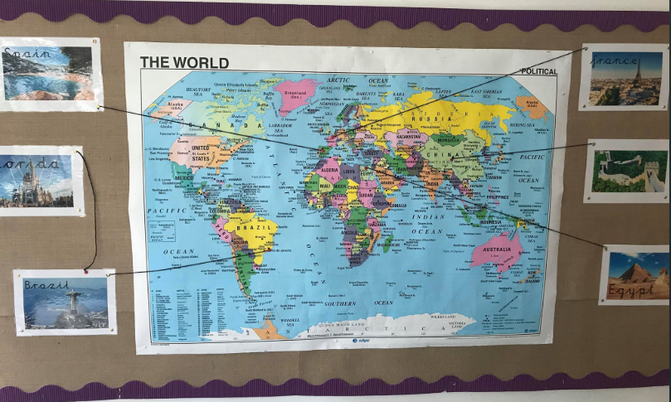
Section A- What is the quality of geography education like?
Context Slip
Criteria met: e.g. A2(i) | A3 (i) and B (i)
Context: what is the evidence, what does it show and how is it hitting the key indicator? | This is in our Reception provision which is accessed by all reception children and their parents. It is a working wall where if a child asks where a place is, the teacher places it on the map and they discuss where it is in relation to England.
Why was this example chosen? | This example has been chosen as it shows that geography is developed and supported from Early years and maps are also used to support children in understanding the world and it’s countries.
What does it show that children know, understand and can do? | It shows what the children know as it is the children who have asked to know where those places are. Whether that is by books which have been read to them by the teacher, discussions with parents or places linked to their themes which they are taught throughout the year.

Slide 25
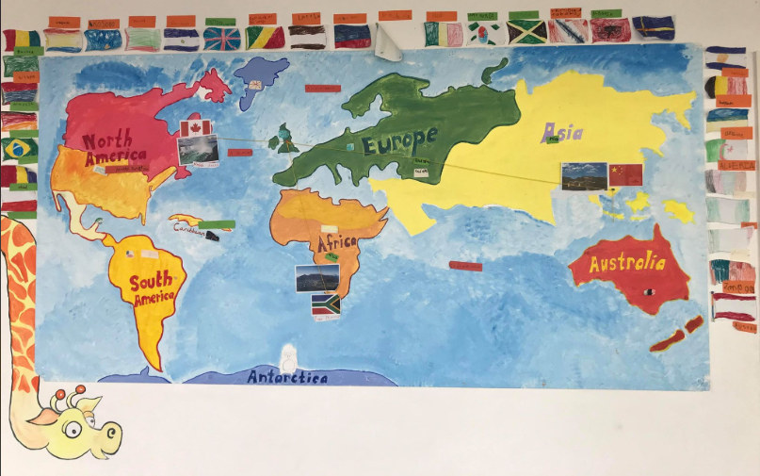
Section A- What is the quality of geography education like?
Context Slip
Criteria met: e.g. A2(i) | A3 (i) and B (i)
Context: what is the evidence, what does it show and how is it hitting the key indicator? | This is the world map which is in the Year 1 and Year 2 provision. It is accessible for all and children will regularly use it for their own learning.
Why was this example chosen? | This example has been chosen as it shows children being able to link places and environments together through the pictures which have been provided next to the continents. Adults supporting provision play a crucial role in supporting children in their understanding of the different places
What does it show that children know, understand and can do? | It shows children being able to access a global map on a scale which allows them to understand the difference between the sizes of continents and beyond. Again, this is a working wall, so throughout the year when a place is learnt about it is added to the wall to support children‘s understanding in the provision.

Slide 26
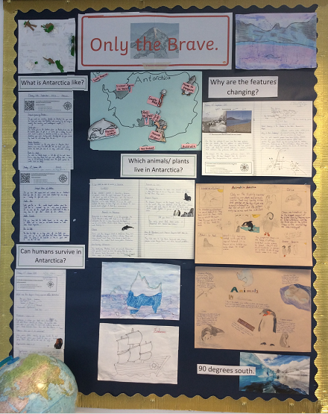
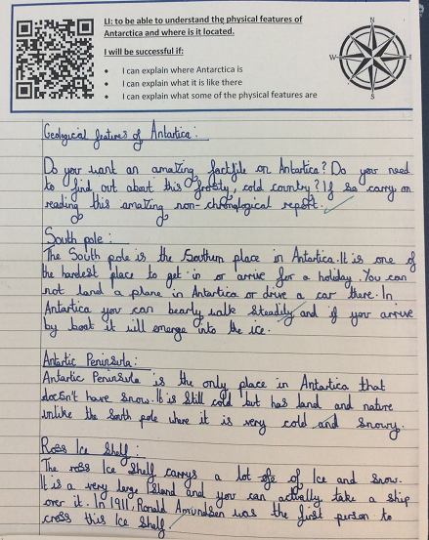
Section A- What is the quality of geography education like?
Context Slip
Criteria met: e.g. A2(i) | A2 (iv) and A3 (i) and B (i)
Context: what is the evidence, what does it show and how is it hitting the key indicator? | This is a display outside of the Year 6 classroom’s which showcases their Geography work linked to ‘Only the brave.’
Why was this example chosen? | This example has been chosen as it shows children having a solid understanding of people, places and environments as children identified where Antarctica was and the geological features.
What does it show that children know, understand and can do? | It shows children research places of interest, they are able to research and identify the geological features of Antarctica such as the Antarctic peninsula which then links to their English text ‘Shackleton’s journey’. Global warming was discussed as it linked to the question, ‘why are the feature changing?’ allowing children the opportunity to understand the impact of global warming.

Slide 27
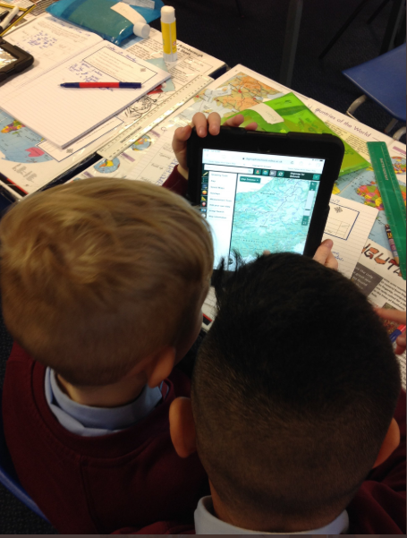
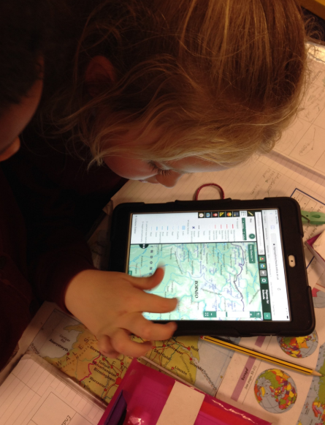
Section A- What is the quality of geography education like?
Context Slip
Criteria met: e.g. A2(i) | A3 (ii) and D (iii)
Context: what is the evidence, what does it show and how is it hitting the key indicator? | Children in Year 3 and 4 using Digimaps to understand the physical features of Borneo- which linked to their topic of ‘Save our world’. Borneo and Sumatra were studied as deforestation was a focus and the impact it has on orang-utans.
Why was this example chosen? | This example was chosen as it shows children using digital mapping to develop their own geographical knowledge and skills. It is where children were using symbols and understanding what each symbol meant.
What does it show that children know, understand and can do? | Children were able to identify physical features of Borneo and they started making links to our local area of Allerton. “We don’t have any mountains in Allerton. Borneo has mountains, I can see it here.”

Slide 28
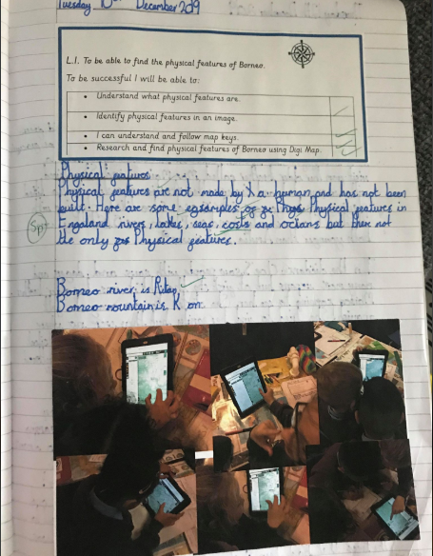
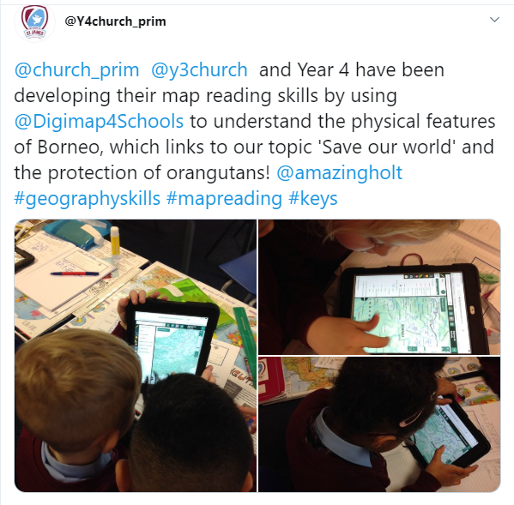
Section A- What is the quality of geography education like?
Context Slip
Criteria met: e.g. A2(i) | A3 (i) A2 (ii) and A2 (iv) and D (iii)
Context: what is the evidence, what does it show and how is it hitting the key indicator? | Children in Year 3 and 4 using Digimaps to understand the physical features of Borneo- which linked to their topic of ‘Save our world’. Borneo and Sumatra were studied as deforestation was a focus and the impact it has on orang-utans. This is the tweet which we used which was re-tweeted by Digimaps and these photos will be used for their training purposes. The written work is what children evidenced when finding the physical features of Borneo. This child has also gone one extra step by naming a river.
Why was this example chosen? | This example was chosen as it shows children using mapping skills which has been enhanced by digital technology.
What does it show that children know, understand and can do? | It shows that children are beginning to understand how to use digi maps and have been able to identify the physical features of a non EU country. They are developing their geography skills and also their geography knowledge whilst recognising physical features on a digital map.

Slide 29
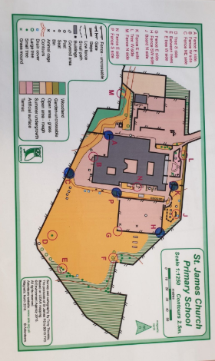
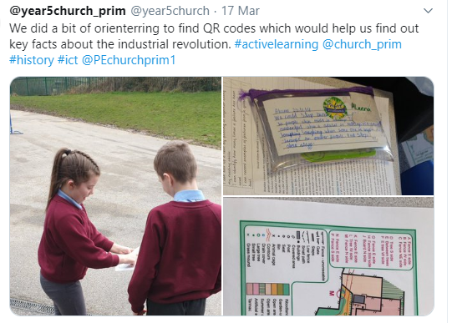
Section A- What is the quality of geography education like?
Context Slip
Criteria met: e.g. A2(i) | A2 (iv) and A3 (ii) , B (i) and B (ii) and D (iii)
Context: what is the evidence, what does it show and how is it hitting the key indicator? | This is a map of the school grounds which uses a key and a relevant scale which children refer to when finding different points around the school grounds. The children used QR codes and went orienteering to help find facts about the industrial revolution.
Why was this example chosen? | This example was chosen as it shows that we use geography skills in all subjects to enhance learning experiences. We are developing mapping and geographical skills with reference to other subjects.
What does it show that children know, understand and can do? | It shows that children see geography as a subject which can support other subjects and that skills can be transferrable and geography is not just a stand alone lesson.

Slide 30
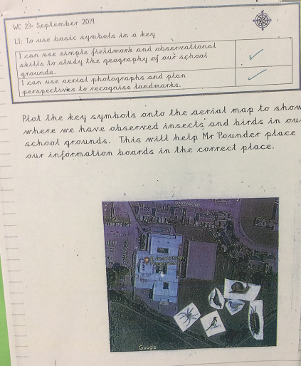
Section A- What is the quality of geography education like?
Context Slip
Criteria met: e.g. A2(i) | A2 (iv) A3 (ii) , B (i) and B (ii)
Context: what is the evidence, what does it show and how is it hitting the key indicator? | This is a year 1 child’s piece of work where the focus was on being able to use basic skills in a key.
Why was this example chosen? | This example was chosen as it shows that we use the school’s surroundings to develop mapping and key recognition.
What does it show that children know, understand and can do? | It shows that children were able to identify where our own nature reserve was in relation to our school, the beck and the main roads. By providing children with this ariel view, children were able to see the school’s positioning in relation to the local area.

Slide 31
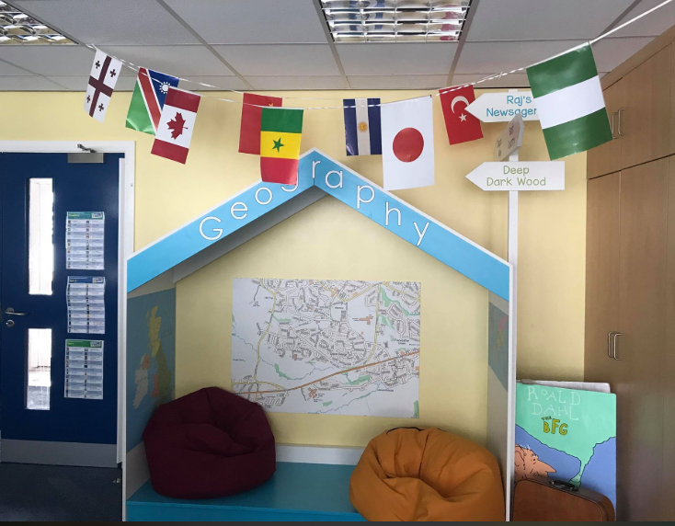
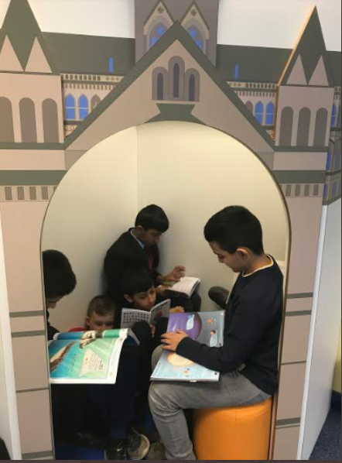
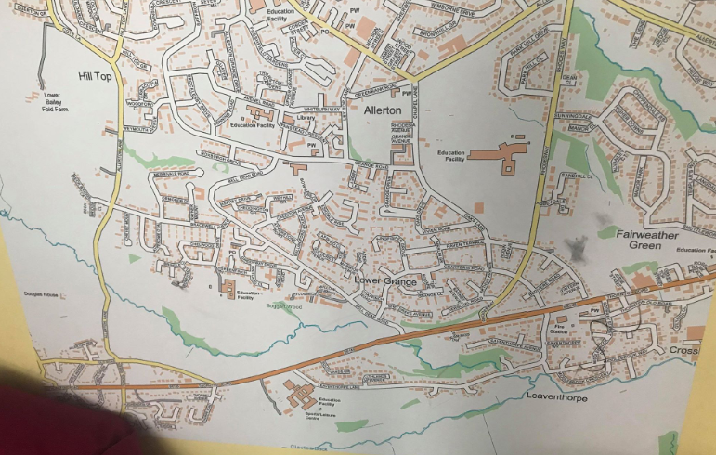
Section B- How does geography education shape behaviour,
attitudes and values?
Context Slip
Criteria met: e.g. A2(i) | A3 (iii) and B (i)
Context: what is the evidence, what does it show and how is it hitting the key indicator? | This is an area of our newly refurbished library. This is the geography section where children are able to explore a different range of maps of our local area. There is a picture of Year 6 boys who are sitting in ‘Cartwright Hall’ which is a building in Bradford. This allowed the boys to ask questions about where Cartwright Hall was thus they used the maps to support their thinking.
Why was this example chosen? | This example was chosen as it shows that geography creates a positive learning environment as children enjoy reading in our geography area where maps of the local area can be explored and discussions can be developed, asking where they live and where their peers live etc.
What does it show that children know, understand and can do? | It shows that children enjoy geography and see it as an integral part of our school due to it being promoted and valued in our newly renovated library which is loved by all children, especially the geography area!

Slide 32
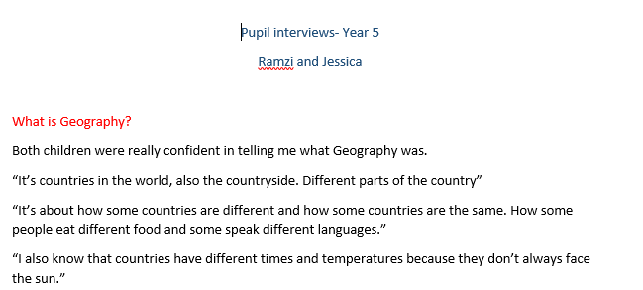
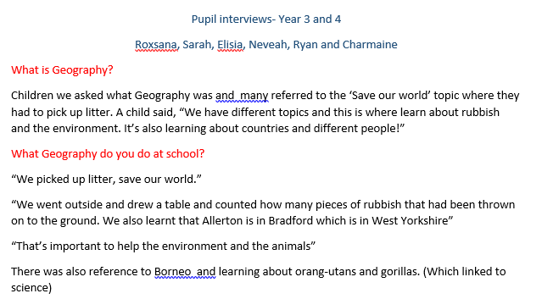
Section B- How does geography education shape behaviour,
attitudes and values?
Context Slip
Criteria met: e.g. A2(i) | B (i)
Context: what is the evidence, what does it show and how is it hitting the key indicator? | The geography lead regularly interviews pupils asking them questions about their geography learning. A range of children were asked, many with SEN, EAL or pupil premium to ensure that all children of all abilities are able to articulate their thoughts about their own geography learning. This interview was conducted in January 2020.
Why was this example chosen? | This example was chosen as it shows that our geography curriculum is enjoyed and valued as the Year 3/4 children were able to tell me about what geography was and how it linked to their topic. ‘Save our world’ where our local area and worldwide issues were discussed.
What does it show that children know, understand and can do? | It shows that children were able to discuss what they had learnt in their unit of work. Many children were able to discuss how geography had affected them socially and how geography is part of the wider world such as climate change.

Slide 33
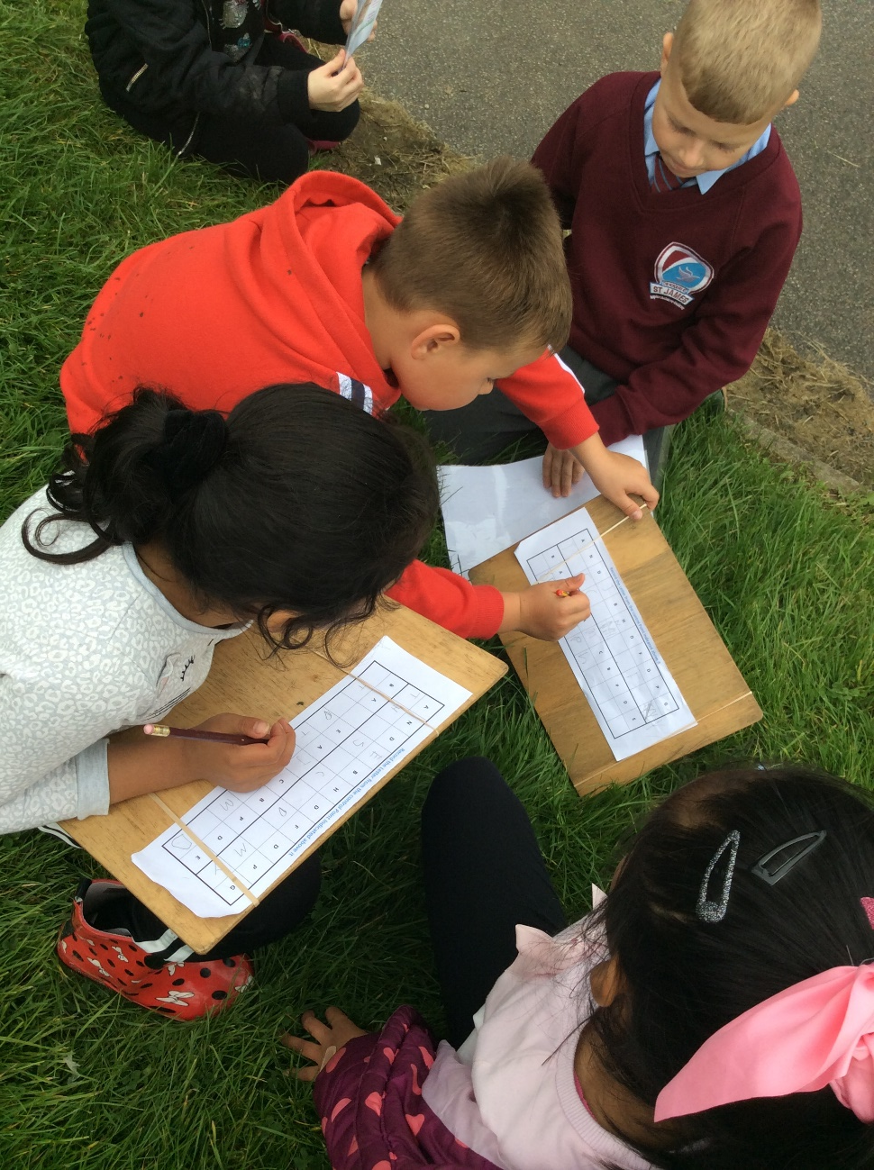
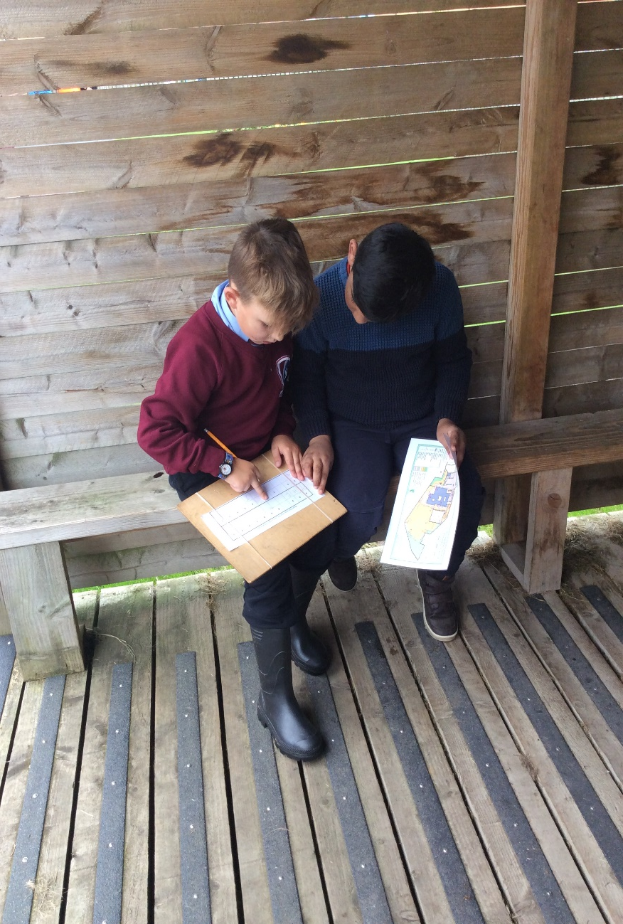
Section B- How does geography education shape behaviour,
attitudes and values?
Context Slip
Criteria met: e.g. A2(i) | A2 (iv) and A3 (i) A3 (iii) and B (i)
Context: what is the evidence, what does it show and how is it hitting the key indicator? | This is when Year 3 class used the map of the school (see pg.29) to develop their orienteering skills. They had to find and navigate points around the school, find a point which corresponded with a symbol which gave them a letter thus allowing them to break the code.
Why was this example chosen? | This example was chosen as it shows that children are enjoying the subject and that it is valued as children are developing their orienteering skills in the safety of the school grounds.
What does it show that children know, understand and can do? | It shows that children are able to read a map, begin to understand scaling on a map whilst working as a team which all contributes to a learning environment where the subject is valued as children are able to understand that geography is ‘hands on!’

Slide 34
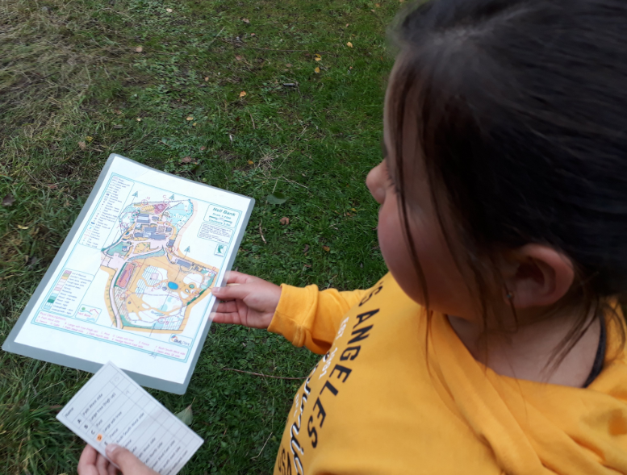
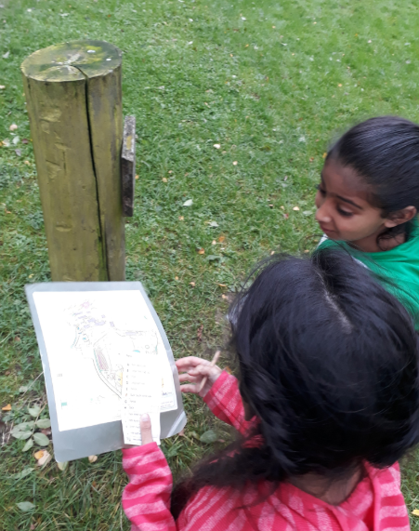
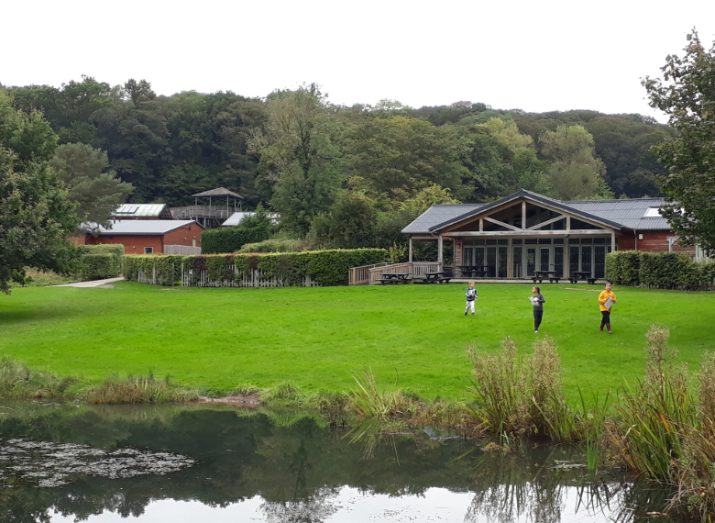
Section B- How does geography education shape behaviour,
attitudes and values?
Context Slip
Criteria met: e.g. A2(i) | A2 (iv) A3 (i) ,B (i), B (ii) and A3 (iii) and D (iii)
Context: what is the evidence, what does it show and how is it hitting the key indicator? | This is one of residential trips which are children go on. Year 4 children are using maps of Nell Bank’s grounds to support their orienteering skills. They had to find different letters at each point and tick off the animal which was at the point.
Why was this example chosen? | This example was chosen as it shows that children are enjoying the subject and that it is valued as children are developing their orienteering skills in the safety of the school grounds.
What does it show that children know, understand and can do? | It shows that children are able to read a map, begin to understand scaling on a map whilst working as a team which all contributes to a learning environment where the subject is valued as children are able to understand that geography is ‘hands on!’

Slide 35
Section B- How does geography education shape behaviour,
attitudes and values?
Context Slip
Criteria met: e.g. A2(i) | A2 (iv) B (ii)
Context: what is the evidence, what does it show and how is it hitting the key indicator? | These are our nurture children who were accessing the outside provision in Year 1 and 2 and the nature reserve. The children are watering the plants and vegetables which we grow in our school.
Why was this example chosen? | This example was chosen as it shows the different opportunities which all children are provided with. They are able to develop their confidence and independence in the safety of the school grounds. They are working safely and with resilience either by making the bedding plants, sowing the seeds or watering the plants.
What does it show that children know, understand and can do? | It shows that children are able to make connections with geography to other subjects and in this instance, science. It also shows that they are able to work safely and geography has been able to provide that opportunity as they are beginning to understand their local area.

Slide 36
Section B- How does geography education shape behaviour,
attitudes and values?
Context Slip
Criteria met: e.g. A2(i) | A2 (iv) and A3 (iii) and B (ii)
Context: what is the evidence, what does it show and how is it hitting the key indicator? | Our reception children walked to the Aldi (our local supermarket) which linked to their topic. They were able to notice different types of houses, they were introduced the vocabulary ‘town’ and they began understand what was in their local area.
Why was this example chosen? | This example was chosen as all our children are given opportunities to develop critical thinking as the reception children were able to notice their natural surroundings, Discussions were had about road safety and they were able to notice similarities and differences to the environment around our school.
What does it show that children know, understand and can do? | This shows that we have an emphasis on children taking risks, especially in the Early Years. As even though, it was a walk to the local supermarket it provided opportunities for children to see geography in their local area, understand where they live and practise being safe by crossing the road correctly and notice hazards around them.

Slide 37
Section B- How does geography education shape behaviour,
attitudes and values?
https://academystjames.com/forest-schools/
Context Slip
Criteria met: e.g. A2(i) | A3 (iii) , B (i) and B (ii)
Context: what is the evidence, what does it show and how is it hitting the key indicator? | These are pictures taken from our school website which showcase the work which we do in our Forest school. Please follow the link which will take you to our school website page all about Forest schools.
Why was this example chosen? | This example was chosen as fire building, den building, obstacle course making and orienteering are just a few of the activities which we do in our Forest school. It provides children, who wouldn’t have access at home, to explore their own surroundings, take risks and be resilient when faced with a challenge.
What does it show that children know, understand and can do? | It shows that children are able to take risks and understand the boundaries of risk taking within the boundaries of the school environment. They are able to build resilience whilst working collaboratively when working outside. Children created their own obstacle course, using the school grounds, allowing them to understand their school environment more.

Slide 38
Section B- How does geography education shape behaviour,
attitudes and values?
https://youtu.be/Tffmrc_4vzY
Context Slip
Criteria met: e.g. A2(i) | A2 (iv) and A3 (iii) and B(ii)
Context: what is the evidence, what does it show and how is it hitting the key indicator? | This is the link which shows the work that our forest school has been doing this year. These are pictures which are of the boys who need extra support either from an SEN or SEMH view point.
Why was this example chosen? | This example was chosen as it shows that this group of boys are able to take risks and push their own boundaries, take risks and work collaboratively- communication is encouraged and demonstrated by the forest school lead, Mr O’Brian who was awarded P.E teacher of the year. He regularly shows the children how to take risks in a safe, controlled environment.
What does it show that children know, understand and can do? | It shows that children are provided a wide range of opportunities to develop their confidence and resilience skills which is underpinned by geography. Emphasising that geography at a school goes beyond a ‘typical’ school environment.

Slide 39
Section B- How does geography education shape behaviour,
attitudes and values?
Context Slip
Criteria met: e.g. A2(i) | B3 (iii)
Context: what is the evidence, what does it show and how is it hitting the key indicator? | This is a pupil questionnaire from a year 5 child. It is where key questions were asked to get an understanding of their understanding of geography.
Why was this example chosen? | This example was chosen as it shows what this child enjoys about geography with reference to learning about different countries and discovering new places. He also made reference to using compasses and how they help with the directional work.
What does it show that children know, understand and can do? | It shows that children are able to articulate their thoughts about geography and how it is linked to everyday life as this child specifies that he likes discovering new places!
** Do student surveys

Slide 40
Section B- How does geography education shape behaviour,
attitudes and values?
Context Slip
Criteria met: e.g. A2(i) | B3 (iii)
Context: what is the evidence, what does it show and how is it hitting the key indicator? | This is a pupil questionnaire from a year 4 child. It is where key questions were asked to get an understanding of their understanding of geography.
Why was this example chosen? | This example was chosen as it shows that due to our high standards of geography lesson, he was able to focus on orienteering being his favourite part of geography, which links to slide 34 where one of the lessons can be seen.
What does it show that children know, understand and can do? | It shows that feedback was taken from the children throughout year either orally or written and teachers have developed on this to create lessons which are engaging and exciting.
** Do student surveys

Slide 41
Section B- How does geography education shape behaviour,
attitudes and values?
Context Slip
Criteria met: e.g. A2(i) | B3 (iii)
Context: what is the evidence, what does it show and how is it hitting the key indicator? | This is a teacher questionnaire which was conducted in November. This teacher specified that he wanted more training, especially with the use of technology when teaching geography.
Why was this example chosen? | This example was chosen as it shows that teachers felt that technology was a weakness and he needed development. After talking to other teachers, this was found to be a weakness by most so a CPD session was booked by Darren Bailey from DigiMaps.
What does it show that children know, understand and can do? | It shows that we, as a school, have created an environment where staff can feel that they can be honest about the training which they need to further develop their own CPD in geography.
** Do student surveys

Slide 42
Section C- How does geography education support pupils’ personal development?
Context Slip
Criteria met: e.g. A2(i) | A3 (ii), B (i) and C (i)
Context: what is the evidence, what does it show and how is it hitting the key indicator? | This a year 5 class on their ‘hook day’ learning about immigration and migration. The hall was used to replicate passport control, children’s pictures were taken, fingerprints were taken and they were given an identity card. This then developed onto their unit of work when they learnt about why people migrated/migrate to Bradford.
Why was this example chosen? | This example was chosen as it shows children’s understanding of the world which they live in whilst being relevant to their local area. It showcases that our geography curriculum are relevant and allow children to be empathetic of other people’s situations.
What does it show that children know, understand and can do? | It shows that children are able to draw on their experiences and relate it to the world in which they live in. By providing the children with these experiences we are ensuring they are responsible and respectful citizens who are able to understand the process which migrants can go through. It allowed children to be reflective on their own family heritage and due to the demographics of our school, many children’s parents are of Eastern Europe Heritage or Pakistani heritage.

Slide 43
Section C- How does geography education support pupils’ personal development?
Context Slip
Criteria met: e.g. A2(i) | A3 (ii), B (i) and C (i)
Context: what is the evidence, what does it show and how is it hitting the key indicator? | This is work following on from Year 5’s ‘Hook day’. It is where they used a range of maps to understand where Syria. Diagrams were drawn to represent the bordering countries, the flag was recognised and the capital city was also identified.
Why was this example chosen? | This example was chosen as It shows that our ‘hook days’ are built upon and developed throughout the unit of the work. In this instance, Syria was learnt about due to learning about migration. The physical and human features of Syria were developed due to a wide range of maps and atlases being used to support learning.
What does it show that children know, understand and can do? | It shows that the children were able to develop on their learning from their ‘hook day’ where they were able to understand

Slide 44
Section C- How does geography education support pupils’ personal development?
Context Slip
Criteria met: e.g. A2(i) | A3 (ii), B (i) and C (i)
Context: what is the evidence, what does it show and how is it hitting the key indicator? | This is more work from the Year 5 classes learning about migration. This piece of work focuses on why people migrate, learning about push and pull factors. In this piece of work, these are highlighted and written about.
Why was this example chosen? | This example was shown as it shows work progressing through the unit of work and how geography is embedded into our curriculum to provide opportunities for children to become open-minded about the world which they live in.
What does it show that children know, understand and can do? | It shows a deeper understanding of why people migrate to another country. It allowed the opportunity for children to discuss, on a more meaningful level, why people choose to migrate and leave their home country. Oracy lessons were planned around these discussions allowing all children to understand different points of view, cultures and lifestyles.

Slide 45
Section C- How does geography education support pupils’ personal development?
https://twitter.com/Y4church_prim/status/1206561920586792960
Context Slip
Criteria met: e.g. A2(i) | A3 (iii) and C (i) and C (ii)
Context: what is the evidence, what does it show and how is it hitting the key indicator? | This is a tweet and a link to the deforestation video which was produced by 2 year 4 children, explaining the impact which deforestation has had on Borneo and the Bornean orang-utans. Follow the link provided and you will be able to watch the video.
Why was this example chosen? | This example was chosen as it shows that our geography is meaningful, it provides children opportunities to explore different lifestyles and choices which people have to make. There were lessons leading to this video, where children understood why local farmers were cutting trees and then a discussion happened about the products which we buy and in turn the terminology, ‘supply and demand’.
What does it show that children know, understand and can do? | It shows that children were able to identify where Borneo is by using digital mapping but they were able to construct their own informative video about the impact of deforestation. They were able to articulate their own thoughts and understand different points of views whilst being responsible and respectful citizens!

Slide 46
Section C- How does geography education support pupils’ personal development?
Context Slip
Criteria met: e.g. A2(i) | C (i) and C (ii)
Context: what is the evidence, what does it show and how is it hitting the key indicator? | This is when the Year 3 and 4 class were learning about their topic, ‘Save our world’. Which linked to the work which Greta Thunberg was doing in 2019. These pieces of work show the cross-curricular link which we made to our English work as the first piece is a poem and the second piece of work is where we introduced expanded noun phrases after watching Great Thunberg’s speech about climate change.
Why was this example chosen? | This example was chosen as it shows that children were able to understand Greta Thunberg’s point of view about climate change. We are always encouraging children to be active and responsible citizens and aware of the world which they live in whilst making links to their other subjects.
What does it show that children know, understand and can do? | It shows that children understand the world in which they live in, they were able to watch her speech and understand Greta’s point of view whilst developing their own view on climate change. It is also important to highlight that due to understanding her opinion they were able to use that knowledge and apply it to their own written work in many contexts, which can be seen.

Slide 47
Section D- How is geography education being led and managed?
Context Slip
Criteria met: e.g. A2(i) | D (i)
Context: what is the evidence, what does it show and how is it hitting the key indicator? | These are the texts which teachers have been using to support their own teaching pedagogy as we have had staff meetings to support our own understanding of Rosenshine and how it can impact our lessons.
Why was this example chosen? | These examples were chosen as it shows the theory behind our lessons and that research underpins our lessons in geography. We are providing high quality lessons and using texts to support our pupils and teachers when delivering geography lessons.
What does it show that children know, understand and can do? | It shows that all staff are supported to improve their own subject knowledge to enhance the geography curriculum within their own year groups and their own class. Developing teachers’ subject knowledge is a continuous progress at our school and we will continue to do so. It is also important to highlight that we focus on Rosenshine’s key principal of reviewing previous learning which then links to assessment.

Slide 48
Section D- How is geography education being led and managed?
https://www.geography.org.uk/Critical-thinking-in-the-classroom
Context Slip
Criteria met: e.g. A2(i) | D (i)
Context: what is the evidence, what does it show and how is it hitting the key indicator? | This is an example to what is shared to all the staff on a weekly basis via email. It is shared via the Geographical Association which is then shared to our staff.
Why was this example chosen? | This example was chosen as teachers read the newsletter which will then support their own pedagogy and deepen their own understanding of geography. As a school, we had a strong emphasis on metacognition and not cognitive overloading the children. Which supports our
What does it show that children know, understand and can do? | It shows what underpins our geography curriculum and we are continuously developing our staff to improve their own thinking of geography and how it can support other subjects. It has also helped to develop the geography leads leadership as well by providing reading resources which can support the next steps for the geography curriculum.

Slide 49
Section D- How is geography education being led and managed?
https://academystjames.com/nature-friendly-schools-project/
Context Slip
Criteria met: e.g. A2(i) | D (i) and D (iii)
Context: what is the evidence, what does it show and how is it hitting the key indicator? | This is an extract taken from our school website. It is an outline of our Nature Friendly school project where staff have begun their training on developing the forest school through the use of our nature reserve.
Why was this example chosen? | This example was chosen as it shows that we are committed to developing staff’s CPD through a wide range of training. We aim to provide ‘hands on’ training to support staff in their development of forest schools and how it can be incorporated into all subjects.
What does it show that children know, understand and can do? | It shows that we are committed to supporting staff’s subject knowledge and they take a keen interest in the geography curriculum.

Slide 50
Section D- How is geography education being led and managed?
Context Slip
Criteria met: e.g. A2(i) | D (i)
Context: what is the evidence, what does it show and how is it hitting the key indicator? | This is the free CPD training on Digimaps which was lead by Darren Bailey via Zoom meetings.
Why was this example chosen? | This example was chosen as it shows that the subject leader listened to staff (pg. 41) and understood that digital technology needed to be taught and developed. Therefore Darren was approached and asked to do a CPD training on Digimaps.
What does it show that children know, understand and can do? | It shows that staff now have a good understanding of how to use Digimaps and are able to use the app when teaching geography in the future. Staff were excited and as a school, we have said that we will support Darren in being able to create a progression document for Early years.

Slide 51
Section D- How is geography education being led and managed?
Context Slip
Criteria met: e.g. A2(i) | A2 (v) D (ii)
Context: what is the evidence, what does it show and how is it hitting the key indicator? | This is ‘subject on a page’ which was completed by the geography lead. It is used in all subjects to understand the areas of strength, areas of improvements, next steps and actions which need to happen.
Why was this example chosen? | This example was chosen as it shows that the geography lead has reflected, identified the next steps for improvement and has understood what needs to happen to ensure that the next steps are achieved.
What does it show that children know, understand and can do? | It shows that the geography lead found that the geography lessons were over complicated and the use of the local area was not used enough. The outcomes of each geography unit needed to be clear and concise showing the skills and knowledge taught, hence why there was training on Digimaps to support this.

Slide 52
Section D- How is geography education being led and managed?
Context Slip
Criteria met: e.g. A2(i) | D (ii)
Context: what is the evidence, what does it show and how is it hitting the key indicator? | This is our geography enquiries overview which was created by the geography lead and an external curriculum advisor. It was devised at the beginning of the academic year. It is currently being reviewed and adapted to suit the needs of our new curriculum. (see appendix 9)
Why was this example chosen? | This example was chosen as it shows that through reflection of the curriculum and monitoring there was not a document like this before. However, the geography lead realised that a document needed to be produced to show the enquiry question and the fieldwork which would link to the unit of work.
What does it show that children know, understand and can do? | This document showed the gaps within our geography curriculum and the next steps that SLT needed to take to ensure that all aspects of the geography curriculum were being taught, this is with reference to page 8 where the curriculum has been re-written and re-structured to ensure there are no learning gaps.

Slide 53
Section D- How is geography education being led and managed?
Context Slip
Criteria met: e.g. A2(i) | A2 (v) D (ii)
Context: what is the evidence, what does it show and how is it hitting the key indicator? | This is an extract taken from our whole school action plan which focuses on the whole of the curriculum.
Why was this example chosen? | This example was chosen as it shows that the main next step was to ensure that curriculum lessons were well sequenced whilst building on knowledge and skills- this was highlighted by Ofsted.
What does it show that children know, understand and can do? | It shows that we understand that we need to ensure the sequence is clear hence the Digimaps training so basic skills can be taught systematically throughout the years and that we can build on the skills year after year.

Slide 54
Section D- How is geography education being led and managed?
Context Slip
Criteria met: e.g. A2(i) | A2 (v) D (i) D (iii) and A1 (iv)
Context: what is the evidence, what does it show and how is it hitting the key indicator? | This is an extract from the BDAT knowledge ladder for geography which was written by the subject leader from our school and another subject leader from St Johns. This document is used (see appendix 10)
Why was this example chosen? | This example was chosen as the 2 leaders worked together to create a document which shows the skills progression in every area of the geography curriculum from Early years to Year 6. Showing the progression from skills, key learning and vocabulary etc. This document has also been shared with staff to allow them to understand what each child needs to be able to do when they enter and leave that specific year.
What does it show that children know, understand and can do? | This shows that the subject leader is able to oversee effective curriculum making by using expertise from another skill whilst creating a document which is now being used by all primary schools in BDAT.

