Slide 1
What are the names of the pop ups we have looked at?
Describe them
Uses one piece of card and that is stuck across a fold.
Needs to be placed at the back of the card.
V - Fold
Internal stand
Is made up from 2 two cuts into the base card.
These are pushed forward and things can be stuck to these.
Parallelogram
Looks like an internal stand BUT uses separate piece of card instead of cutting the base card.

Slide 2
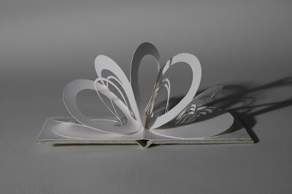
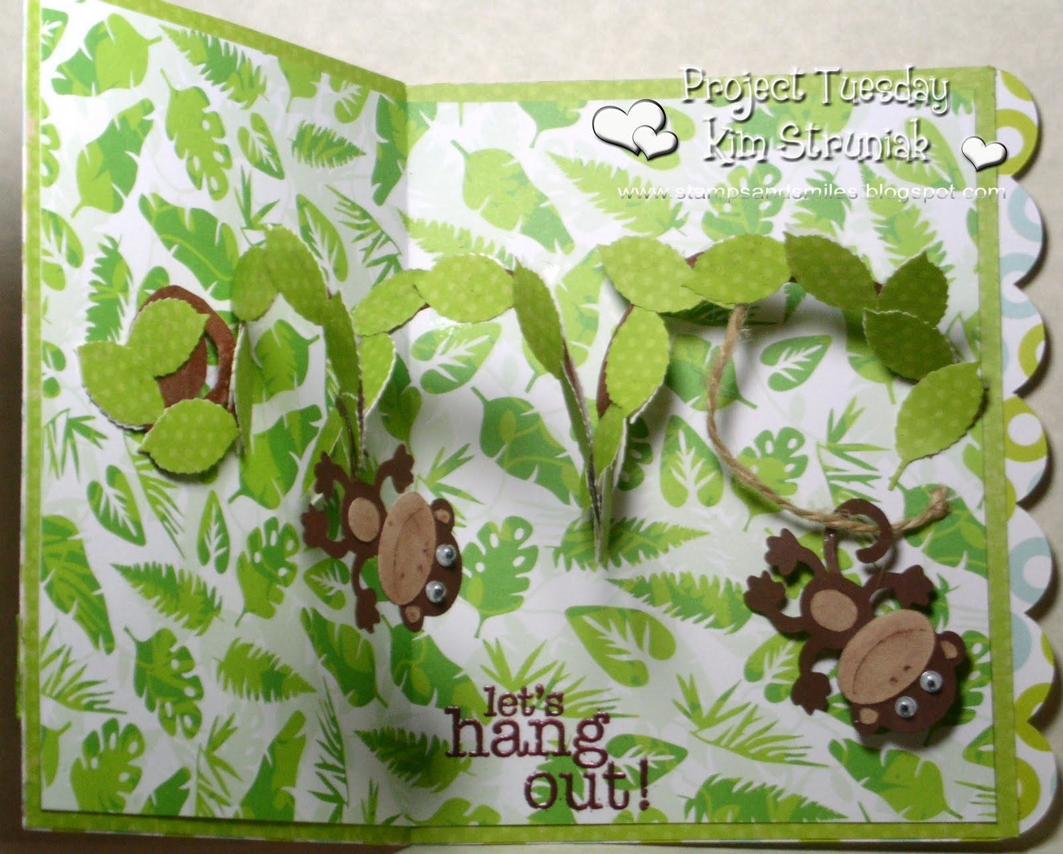
Spiral Pop Up

Slide 3
I am: making a spiral pop up example
So that I can: understand the technique needed to make this pop up movement
I know I’ve got it when: I have a working spiral pop up card.
TASK
1. Create a Spiral pop up
2. Stick your card in to your book
3. Write out the steps you undertook to create your pop up AND include mini sketches to help illustrate these.
EXTENSION 2
Experiment with combining any of the pop up methods we have looked at.
Success Criteria
What have you done?
Created at least one spiral pop up.
Have the basic steps written down.
EXTENSION 1
Experiment with adding more than one spiral AND sticking items to the spirals.
Have made detailed notes on each of steps.
Have attempted 2 or more interlocking spirals
Will have tried adding items to the spirals.
Target Work
for students…

Slide 4
Review
Have your pop up card from the lesson out and be ready to discuss it.
What did not work?
What did you find difficult?
How easy was each step?

