Slide 1
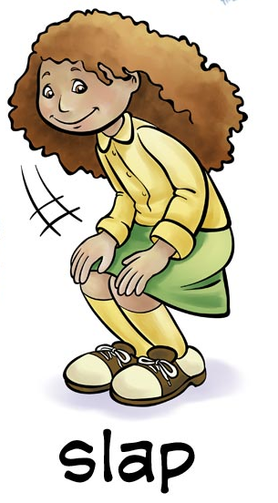
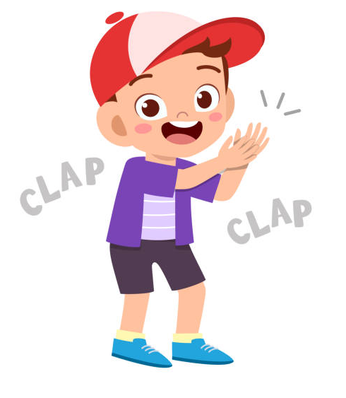
Body Percussion
Here are two videos to watch….
Here is an incredible video of a choir making the sounds of a thunderstorm with just their bodies!! Listen out for the quiet and loud dynamics...
- Can you copy their actions?
Angel City Chorale perform “Africa”
https://youtu.be/-c9-poC5HGw
Have a go at your own body rhythm by joining in with this video.
- Can you keep in time with the music? How accurate can you be?
Can’t Stop the Feeling body percussion
https://www.youtube.com/watch?v=92gf8dAlhUw

Slide 2
Body percussion
Here is a body percussion challenge.
Can you design your own song using just body percussion?
Start by counting how many sound effects you can make with just your body. You could start with:
Clapping your hands
Clicking your fingers
Stamping your feet
Notice how each sound effect is different – they can be loud or quiet (dynamics) or they could be high or low (pitch).
Try joining the different effects together to make different rhythms.
If you’re feeling adventurous you could design a sound effect song – maybe about the Jungle, Under the Sea or a Haunted House!
Try recording your piece and submitting it to Dojo or Twitter!

