Slide 1
Pollination and Seed Dispersal

Slide 2
The life cycle of a plant

Slide 3
Flowering plant life-cycle
There are 4 stages to the life-cycle of a flowering plant:
POLLINATION
FERTILISATION
SEED DISPERSAL
GERMINATION

Slide 4
Parts of a flower
petal
stigma
style
anther
filament
ovary (containing the ovules)
sepal

Slide 5
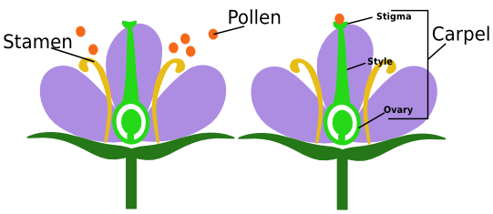
Parts of a flower
Male part:
The anther carries pollen which contains the male germ cell.
Female Part:
Inside the ovary are ovules which contain the female germ cell.

Slide 6
The male and female parts are involved in a process called pollination.
What is pollination?
https://www.youtube.com/watch?v=V5yya4elRLw

Slide 7
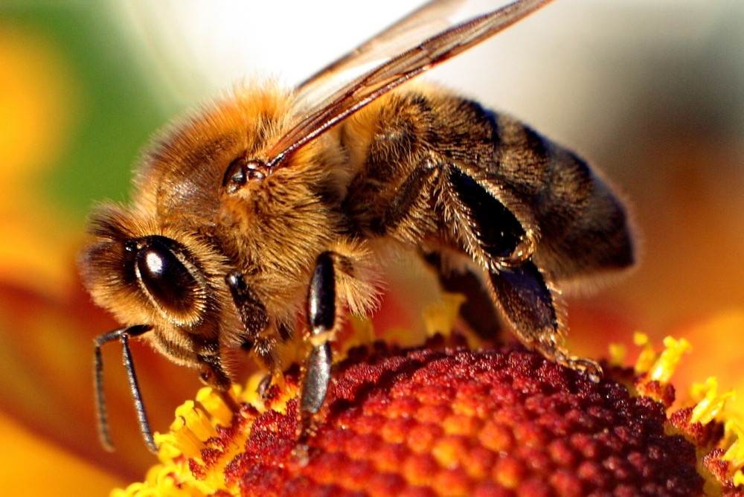
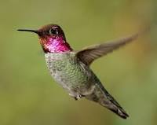
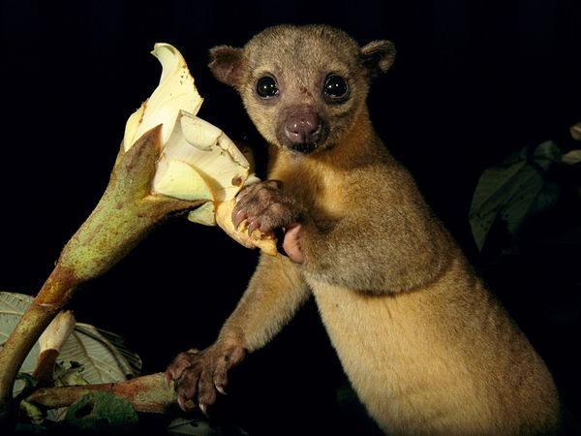
What animals are involved in pollination?
Birds – Hummingbirds
Insects – Bees, Butterflies and Ants.
Mammals – Bats and Kinkajous.

Slide 8
Pollination
2.a) Wind can carry pollen between flowers
1) Pollen is taken from the anther
3) The pollen sticks to the stigma
WIND
INSECT
2.b) Insects can carry pollen between flowers

Slide 9
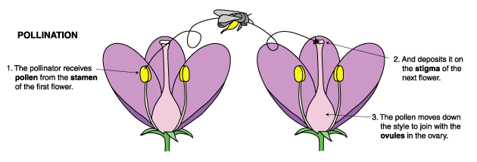

Slide 10
Fertilisation
Once the pollen has landed on the stigma, a pollen tube grows down the inside of the style.
When the tube reaches an ovule, fertilisation takes place and a seed forms.

Slide 11
Seed dispersal
Once an ovule has been fertilised it will become a seed. To avoid competition (for light, water, etc.) with the parent plant the seed will be dispersed.
Dispersed by animals - seeds can be contained within a fruit or attach to fur/skin
Dispersed by wind - seeds can be very small and light or have an adapted fruit that catches the wind.
Dispersed by 'explosion' - seeds are thrown from the parent plant.
http://www2.bgfl.org/bgfl2/custom/resources_ftp/client_ftp/ks2/science/plants_pt2/dispersal.htm

Slide 12
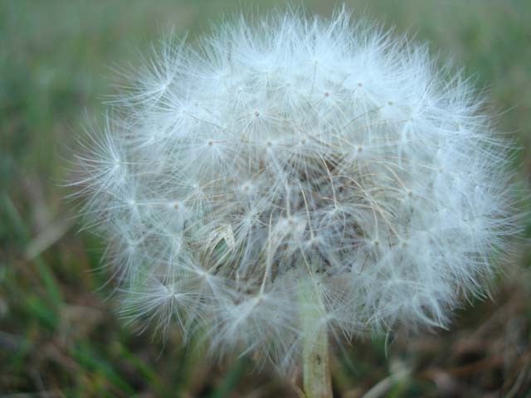
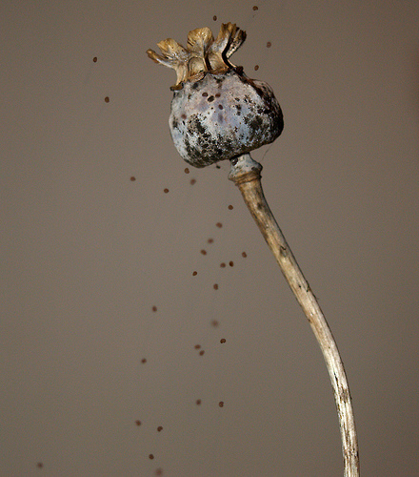
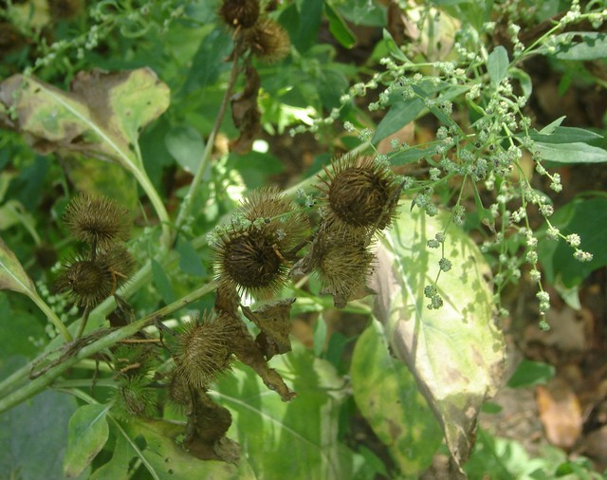

Slide 13
Germination
When the conditions are suitable (e.g. warmth and moisture), a seed will germinate. Germination is the first stage of growth.
1) a root emerges from the seed coat.
2) Using energy stores, the seed produces a shoot
3) Seed leaves appear allowing the plant to start photosynthesis

