Slide 1
Year 6
Wednesday

Slide 6
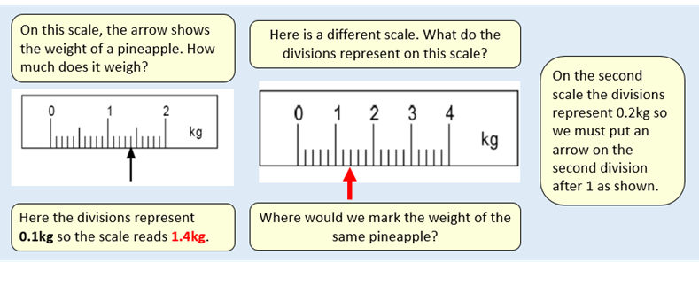

Slide 8
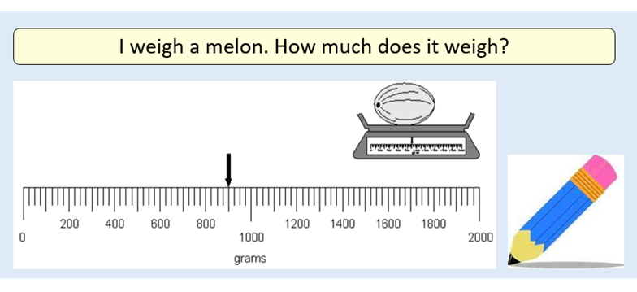

Slide 10
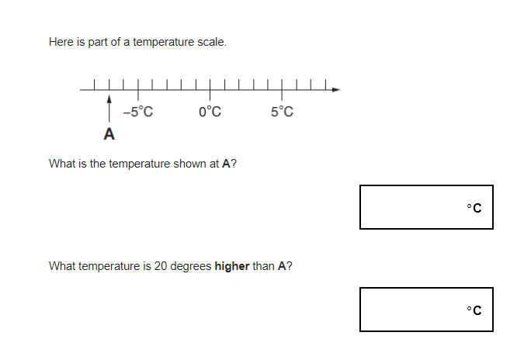

Slide 12
Guided reading

Slide 16
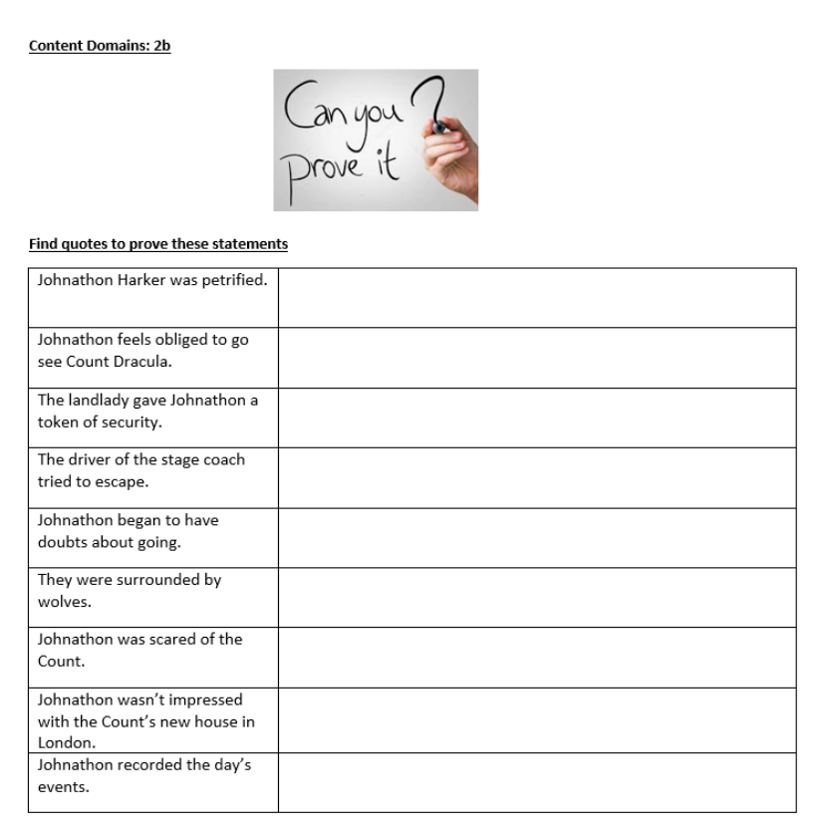

Slide 17
Wednesday 6th January
English

Slide 21
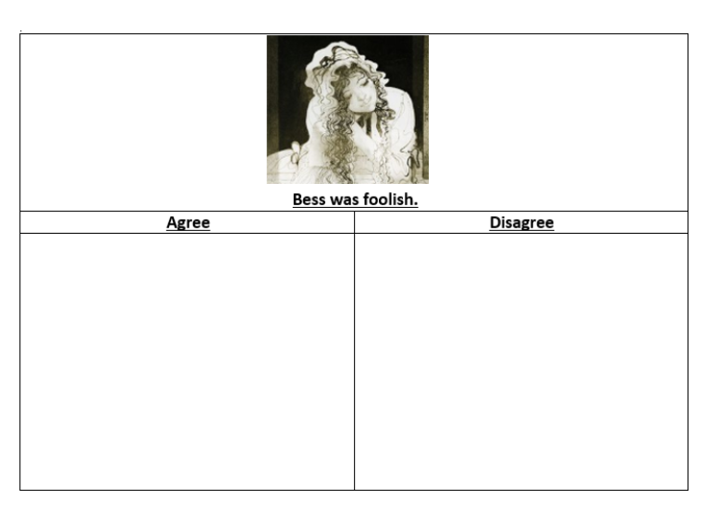

Slide 22
