Slide 1
Lesson 1
Online content
Upper Key Stage 2 (9-11 year olds)

Slide 2
Learning objectives
I know that not everything online is trustworthy
I can recognise some of the differences between fact and opinion
I can make decisions about what I trust online using clues

Slide 3
Trust is…
You believe that someone or something is telling you the truth.
Trust is…
You can rely on someone / something.

Slide 4
Notes:
To find out more about any of these apps then visit;
www.commonsensemedia.org
www.net-aware.org.uk

Slide 5
Task
Sort all the things you can see online into the following table based on whether you think they are trustworthy.
5 minutes
Trust
Can’t trust
Not sure
Comments
Blogs
Facts
Images
Links
Hashtags
News
Quizzes
Videos
Maps
Websites
Search engines
Challenge - can you think of any of your own?

Slide 6
10 minutes
Task – Good game?
You will need to rank the next 5 sources of information and decide which is the most trustworthy.
- Which source gives the best and most accurate account of the game?

Slide 7
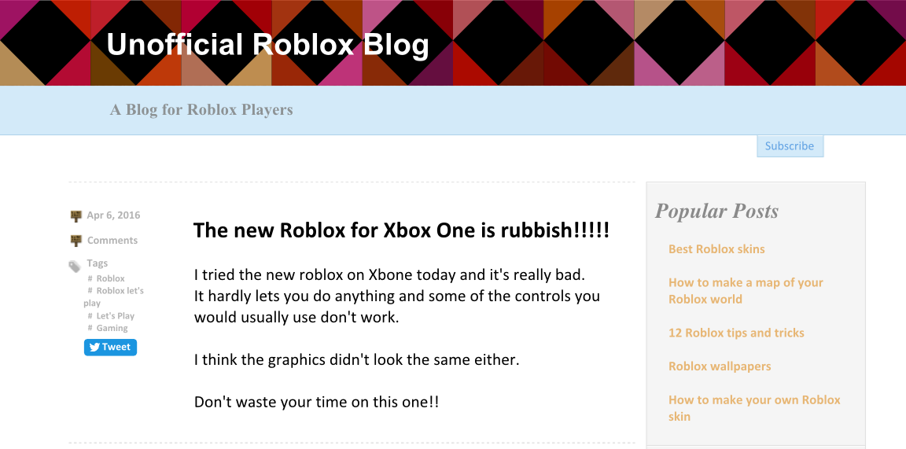
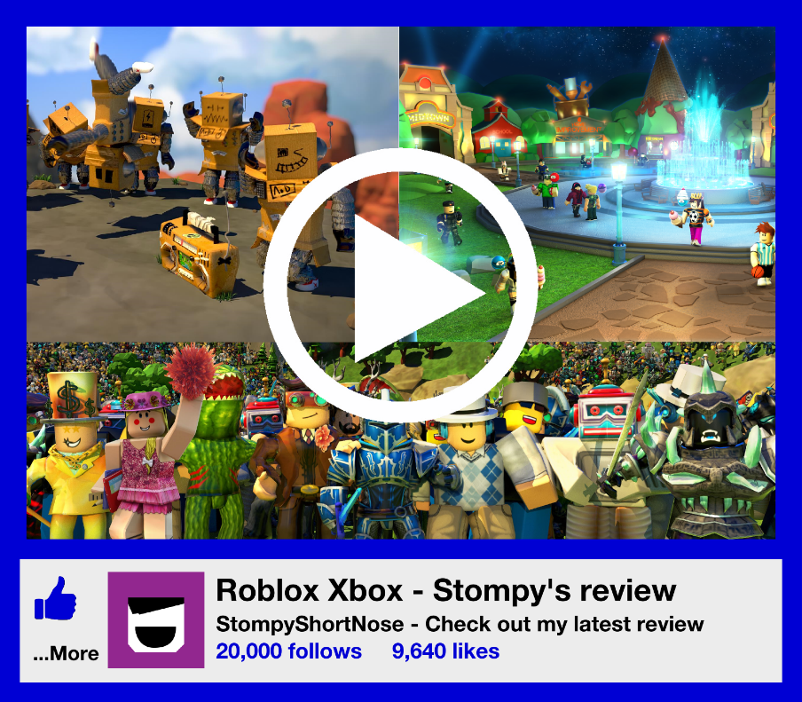
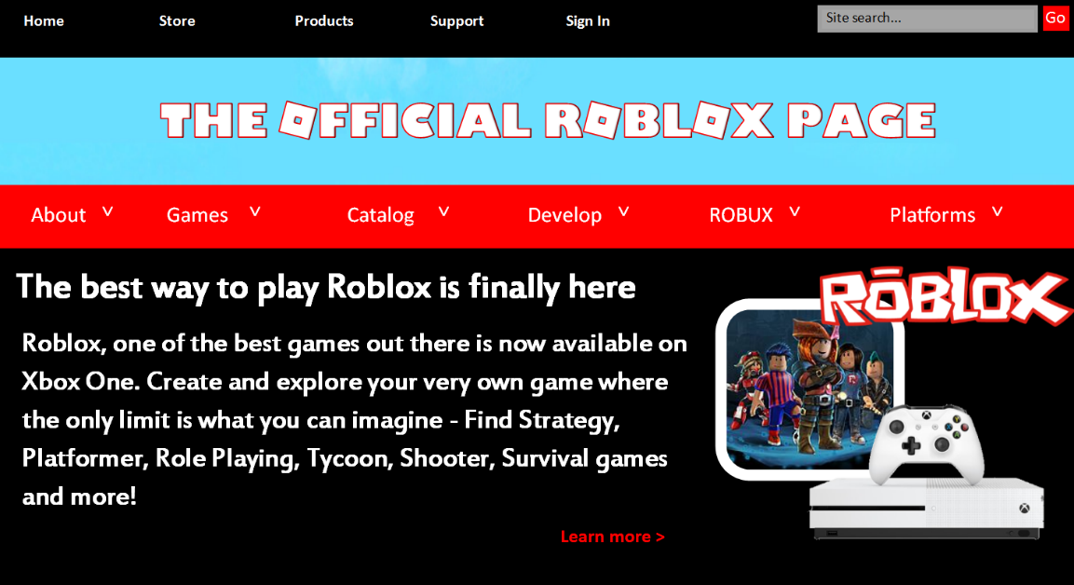
Which would you trust? Why?
Put them in order of trustworthiness

Slide 8
1
An unofficial blog

Slide 9
2
An online advert

Slide 10
3
Online messages and comments

Slide 11
4
A website

Slide 12
5
An online video review

Slide 13
Which would you trust? Why?
Put them in order of trustworthiness

Slide 14
What are we looking out for?
10 minutes
How do I find reliable information online?
Task – What are we looking out for?
Write a checklist of things you would look out for when judging if something online is trustworthy.
1
…
2
…
3
…

Slide 15
10 minutes
I want to download and watch Toy Story! Which link shall I click on?
Task – Searching for the truth
Look at the following search results for downloading Toy Story and decide which link to click on. Think about;
Which one will let you download the film?
Will it cost any money?
Are there any websites which you wouldn’t trust?
How have the websites been ordered?

Slide 16
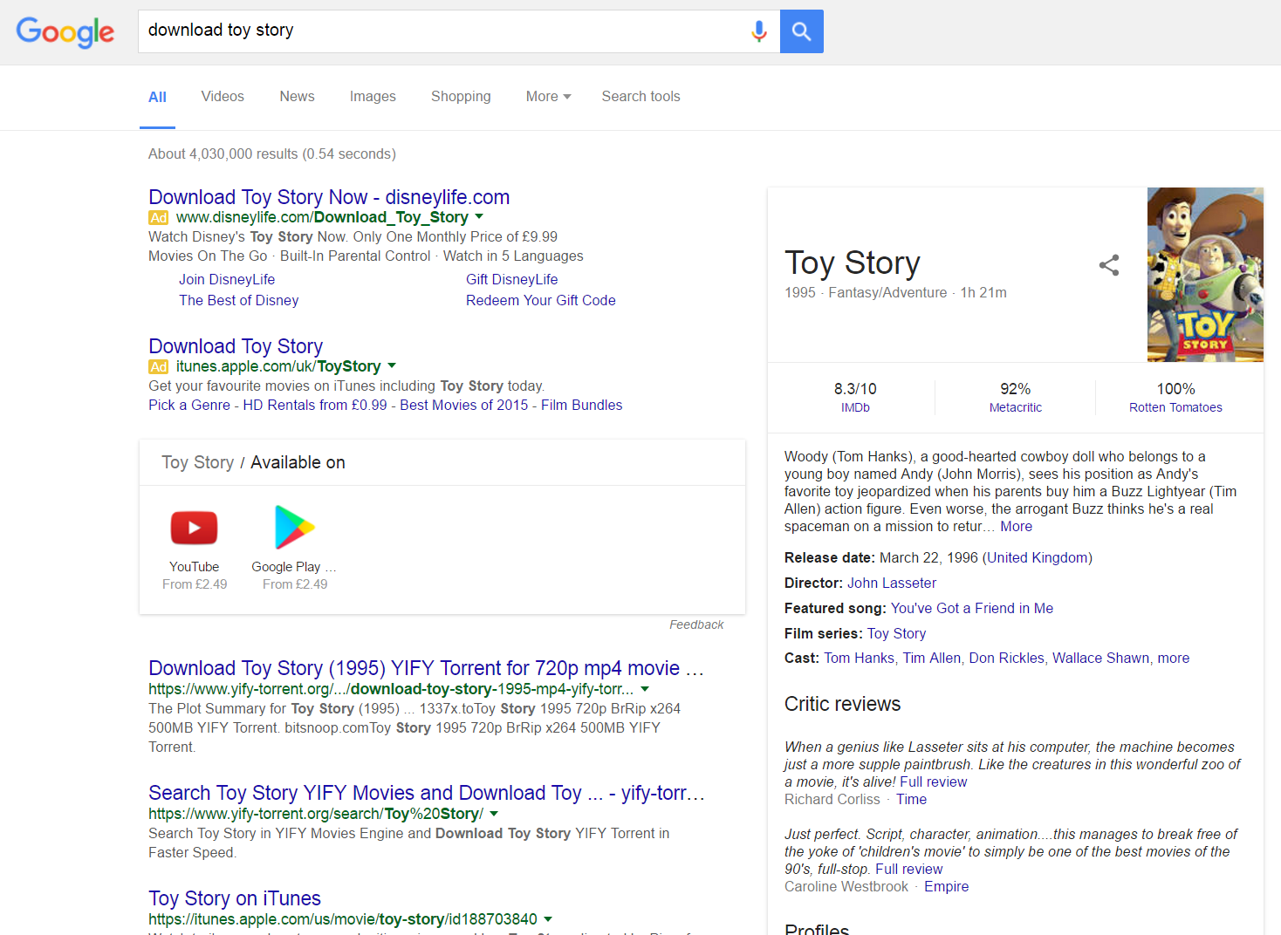
Searching for the truth
Ad
Ad

Slide 17
What are we looking out for?
☑
Is there anything we can add to our checklist to make sure we click on the most reliable search result?

Slide 18
How can we check?
I’ve found something online which I think is reliable but how do I check?
?
Check it on at least three different websites
Check in a book
Talk to someone about what you found

Slide 19
Does this mean we can’t trust anything online now?
HELP

Slide 20
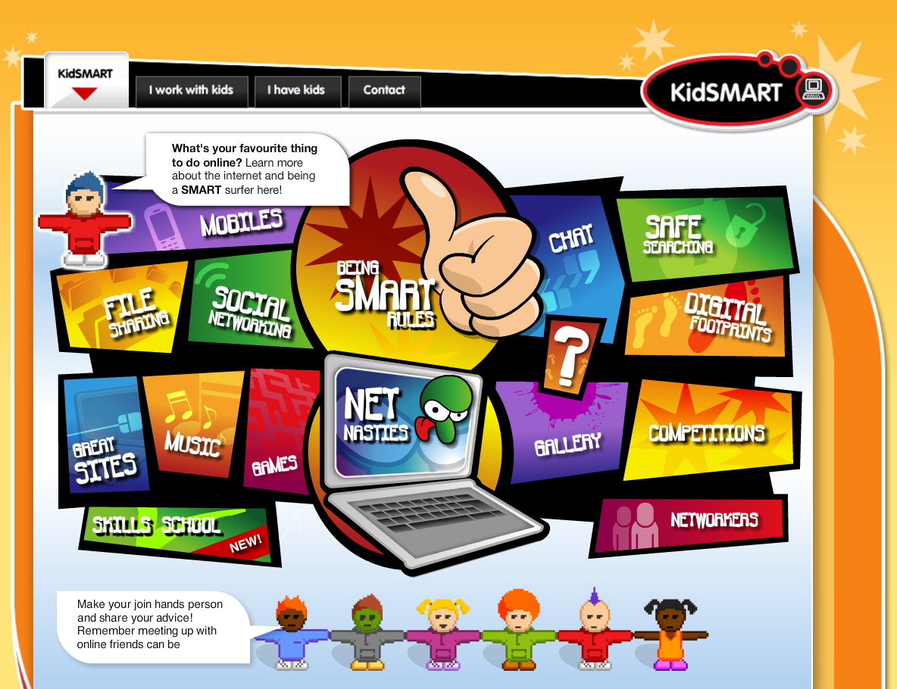
www.kidsmart.org.uk

Slide 21
Available from:
www.childnet.com/trustme
trustme.lgfl.net
Trust Me by Childnet International is licensed under a Creative Commons Attribution-NonCommercial-ShareAlike 4.0 International License.

