Slide 1
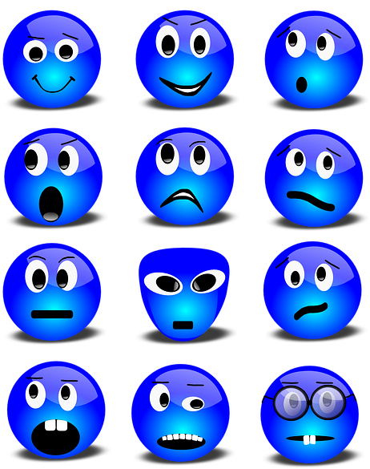
Lesson 1:
Everyday feelings

Slide 2
Ground rules
[Add your class rules here]
Notes:
Teacher Notes
Use this slide to display your class agreement / ground rules for PSHE education lessons. See Accompanying Teacher Guidance Notes (separate document). At the beginning of the lesson, establish or reinforce existing ground rules – add or emphasise any ground rules that are especially relevant to this lesson.

Slide 3
Everyday feelings:
What’s our starting point?
Imagine a person, about your age (or a bit older than you), who goes to a school like ours, somewhere near here.
Draw and write about:
the feelings they have most days
what helps them to feel good every day
Notes:
Teacher Notes - Baseline assessment – feelings draw and write (10 mins).
Ensure this activity is completed before delivering the lesson.
Provide pupils with a piece of blank A4 paper on which to respond. The purpose of this activity is to enable the you to find out the pupils’ existing knowledge, skills and attitudes towards choosing what to watch. Pupils should work individually. Whilst they are working, do not prompt them in any way. When complete, ensure pupils write their name at the top of their paper. Collect in and check pupil responses, noting any responses and any misconceptions that need addressing through the lesson. Keep the papers - pupils will return to this activity at the end of the lesson and the results used to assess their learning.

Slide 4
We are learning about the different feelings and emotions people experience; how feelings and emotions change and what helps people to feel good
We will be able to:
identify that feelings/emotions are part of our health and wellbeing
recognise that feelings usually change throughout the day
give examples of everyday things that can affect feelings
describe what can help people feel good/better
Notes:
Teacher Notes – Learning objective and outcomes
Introduce the learning objectives and outcomes

Slide 5
What is a feeling?
A feeling is an emotional state or our reaction to something. Feelings are important because they help us to manage different situations and look after ourselves. Feelings and emotions are about our minds but we might also experience them in our bodies.*
Notes:
Teacher Notes – What is a feeling? (5 mins)
In small groups pupils talk about feelings: what a feeling is and does, then display the definition and discuss with the class.
We suggest using the terms feelings and emotions interchangeably as their definition is similar, but for information these words can be defined as:
Emotion: a strong feeling deriving from one's circumstances, mood, or relationships with others; an instinctive or intuitive feeling as distinguished from reasoning or knowledge
Feeling: an emotional state or reaction, an idea or belief, especially a vague or irrational one, or the adjective feeling: showing emotion or sensitivity
(*) ©Google dictionary definition (accessed: 05/06/2019)

Slide 6
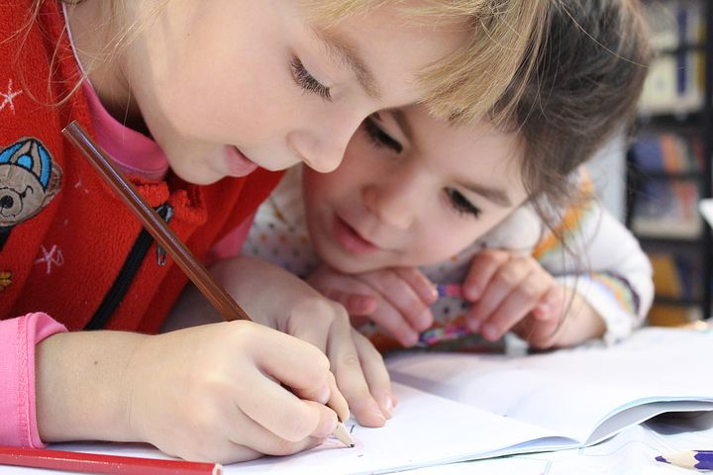
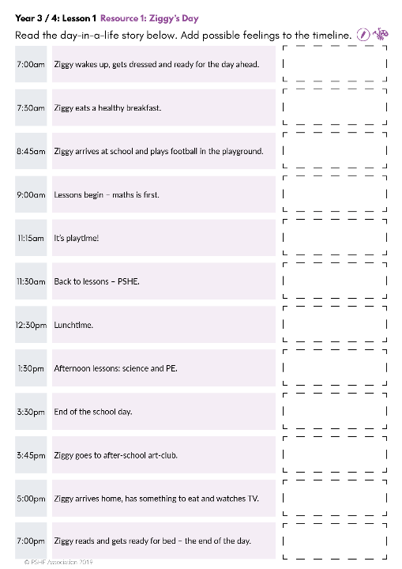
Ziggy’s day
Everyday, we have different feelings!
What different types of feelings might someone experience in one day?
Work in pairs to add Ziggy’s feelings to the timeline.
How much do Ziggy’s feelings change throughout the day?
Notes:
Teacher Notes – Timeline of feelings (10 mins)
Remind the pupils of their learning from KS1; that we have lots of different feelings all the time and that different things can influence and affect our feelings; that our feelings change often.
Using Resource 1: Ziggy’s day, pupils demonstrate their understanding of this by working in pairs to plot a character’s possible changing feelings at different times of the day.
Discuss how much Ziggy’s feelings changed throughout the day. Compare the different feelings they thought Ziggy might experience at different times.
Pupils may have different responses and you may need to reiterate that people often feel differently about different things (Refer back to KS1, Year 1 and 2: lesson 2).
Support: Provide printed cards (pictorial or written) showing a range of feelings – pupils match appropriate cards to the timeline. Some pupils may need additional adult support to talk about Ziggy’s feelings at different times of the day.
Challenge: Pupils describe the feelings Ziggy experiences in more detail and explain why Ziggy feels like that at different times of the day.

Slide 7
How does it feel?
Card sort…
Take turns to choose a card and decide whether it would give a good, not-so-good or neutral feeling.
Is it a good day or not-so-good day?
Which things made the day feel better?
Remember, we might feel differently about different things
Notes:
Teacher Notes – Card sort: How does it feel? (15 mins)
Reflecting on the previous activity, briefly highlight how Ziggy’s feelings were influenced by or in response to things happening.
To explore this concept further, provide groups of pupils with envelopes containing a set each of Resource 2: Moments cards.
Pupils take it in turns to draw a card from the envelope, then decide as a group whether it would give a good, not-so-good or neutral feeling, and place the card in groups on their table. As for the previous activity, note that people might feel differently about different things.
After a short time, stop the group work (they may not have used all the cards from the envelope). Ask them to assess whether, according to the moments cards, it was a good day or not-so-good day, so far. Discuss the types of things that made the day better or worse; things we can control and things we can’t. Allow the pupils to continue the activity until they have used all the cards.
Point out that some of the examples on the cards can be interpreted as online behaviour as well as offline; the emphasis on this will depend on the experience of the pupils in the class and teaching should be adapted as necessary. Examples include: there is an argument in the group; someone says something nasty to someone else; no-one wants to play today; someone is not included.

Slide 8
Feeling good every day
There are different ways we can help make our days feel better even if it’s not going so well.
Notes:
Teacher Notes – Feeling good everyday
Discuss with the class that there are some ways we can help to make our days feel better, or to help recover if something happens that doesn’t make us feel good and that this is all part of looking after our feelings and emotions (our mental health).

Slide 9
Sammi’s blog
Ziggy’s older brother, Sammi has written an online article about different ways to feel better every day.
Read the blog.
What ideas does he suggest?
Notes:
Teacher Notes – Blog stimulus and signposting support (10 mins)
In pairs, pupils read Resource 3: Sammi’s blog post and identify the different ways Sammi suggests people can feel good every day (or better, if something feels not-so-good). Discuss their opinions on the blog. Do they like the ideas? Have they got any others to suggest?
This might include things like: having a hug; thinking of something or somewhere nice; healthy food or talking to mum/dad.

Slide 10
Remember!
For more help and advice, or to find out more about your feelings, talk to an adult you trust.
Talk to a trusted adult at home or at school
ChildLine: www.childline.org.uk
0800 1111
If you feel bad, sad, upset or just not so good… or if something happens that worries you, you can also look for advice at ChildLine or Thinkuknow (online).
Notes:
Teacher Notes – Blog stimulus and signposting support (10 mins)
Ensure pupils are aware to tell someone if something happens that makes them feel not so good often (every day or most days) or if a one-off moment makes them feel bad.
Signpost to:
Parents, carers, teachers or other trusted adult in the first instance
CEOP https://www.thinkuknow.co.uk/ to report issues online
ChildLine https://www.childline.org.uk/ 0800 1111

Slide 11
Feel-good note-cards
Help Ziggy feel good…
What can Ziggy do to feel good or better throughout the day?
Write a note-card for Ziggy to keep in his pocket or wallet as reminder!
Notes:
Teacher Notes – Plenary: Feel-good note-cards? (10 mins)
Ask the pupils to write a reminder message to Ziggy suggesting one idea to manage feelings positively every day. Use the sticky-notes or pieces of card. Pupils can think back to the timeline activity to help them think of suitable ideas for Ziggy.

Slide 12
Every day feelings:
Where are we now?
Go back to the ‘What’s our starting point?’ activity
Is there anything you would like to change?
Is there anything you would like to add?
Use a different colour pen or pencil to amend your draw and write and show how your thinking has developed or changed.
Notes:
Teacher Notes – End-point assessment (10 mins)
Give each pupil their Feeling good draw and write activity from the beginning of the lesson and a different coloured pen or pencil. Ask pupils to amend their original ideas or add their new learning to their work.

Slide 13
Additional activity
Write a story about Ziggy’s day. Tell your reader about all the different feelings Ziggy has in one day, which things make him feel good and which things make him feel not-so-good. Write about what he does to feel better.
Notes:
Teacher Notes – Extension activities
These activities can be included if you have additional time in the lesson or afterwards, to challenge pupils who need to be stretched or for pupils who demonstrate a particular interest in this topic.
Pupils write a story using Resource 2: Ziggy’s day as a story planning tool. They describe the feelings Ziggy experiences and explain why Ziggy feels like that at different times of the day.

