Slide 1
Music

Slide 2
Intent
Our intention is that, when children leave Academy St James, they do so with the knowledge, understanding and emotions to be able to play an active role in today’s society. We want our children to have high aspirations, a belief in themselves and realise that anything is possible if they put their mind to it.
What do we want for our pupils?
· Develop a confidence in sharing their own thoughts and opinions with others
· Develop skills and attributes to keep themselves healthy and safe
· Develop an attitude of a responsible global citizen
· To show tolerance of others beliefs, religions and life choices.
· To build positive, respectful relationships with other people

Slide 5
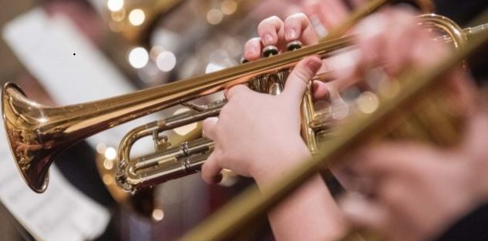
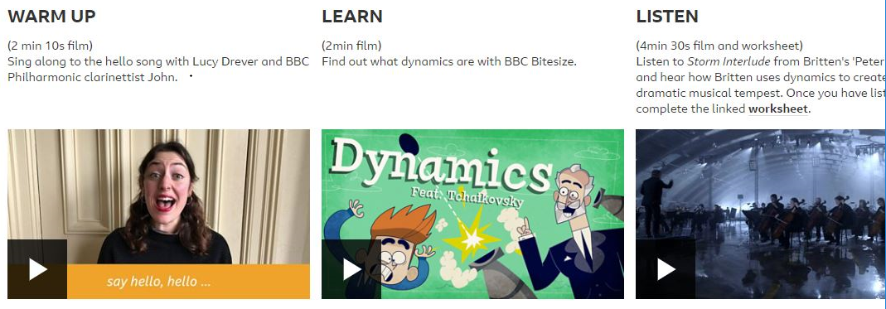

Slide 6
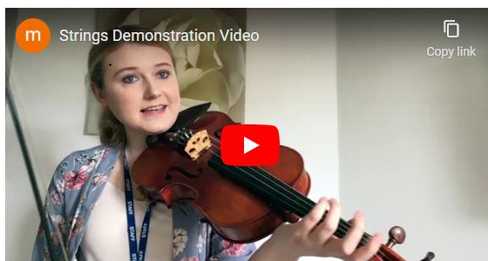
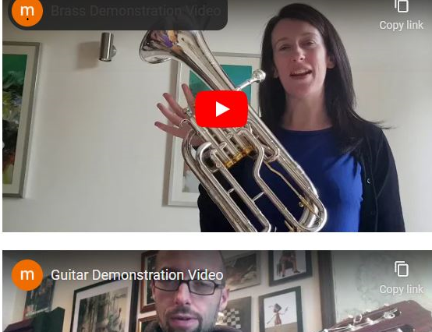

Slide 7
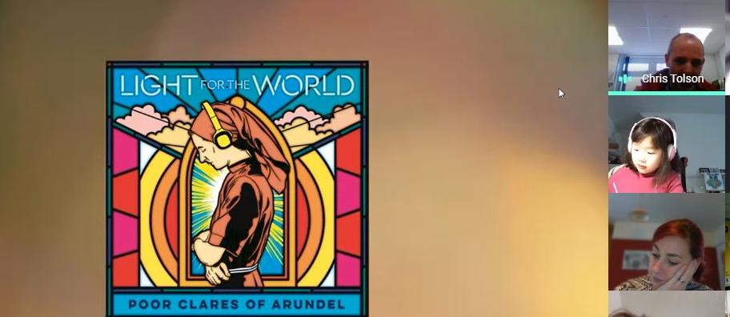

Slide 8
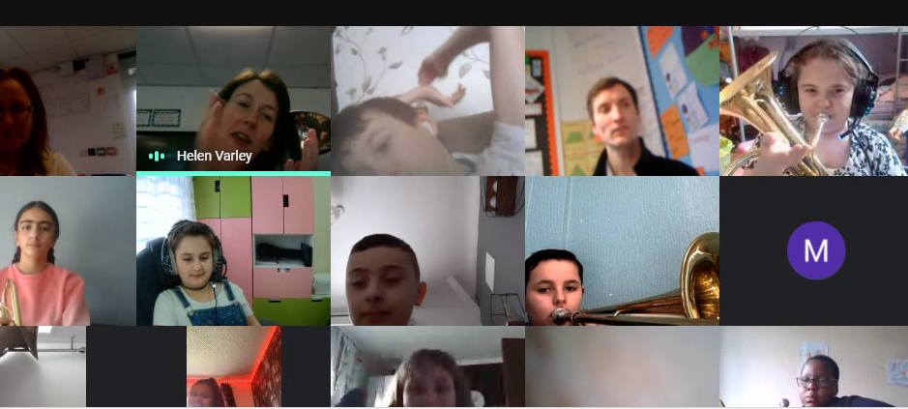
Home learning and music in school.

Slide 9
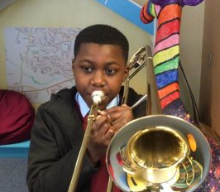
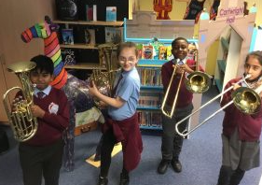
Year 5 Band

Slide 10
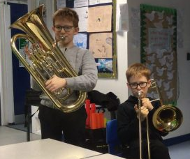
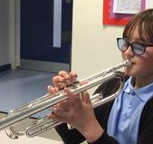
1:1 lessons and small groups

Slide 11
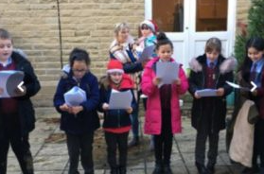
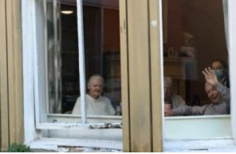
Music to support the community.

Slide 12
https://drive.google.com/drive/u/0/search?q=owner:rebecca.smith%40academystjames.com
Christmas music
https://drive.google.com/drive/u/0/search?q=owner:helen.gibbons%40academystjames.com

Slide 13
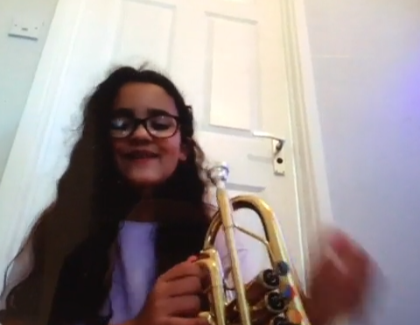
Music during home learning
https://www.dropbox.com/s/8s11byre6uvrpn1/2A524DF6-7D65-4347-899A-B592C3FB8DBE.MOV?dl=0

Slide 14
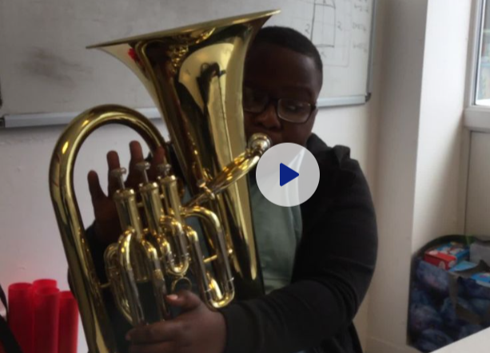
https://www.dropbox.com/sh/ou29nt6f7i7sywx/AACnenYNY-NHXVDK8oAQ7pbEa?dl=0&preview=11B568B5-694B-4602-A452-8BE151836023.MOV

Slide 15
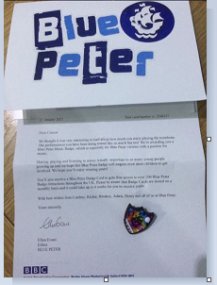

Slide 16
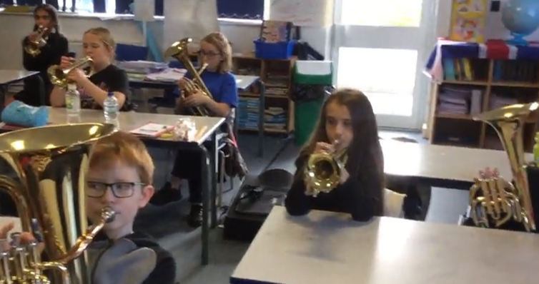
https://www.dropbox.com/sh/ou29nt6f7i7sywx/AACnenYNY-NHXVDK8oAQ7pbEa?dl=0&preview=E0D184B0-E7CF-408D-AD42-8B6247221995.MOV

Slide 17
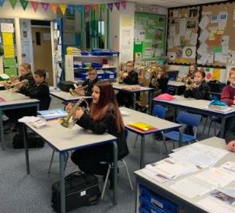
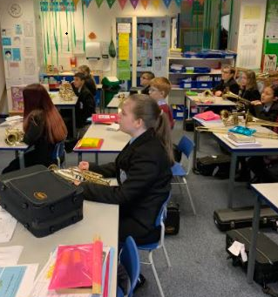
Music lessons during lock down.

Slide 18
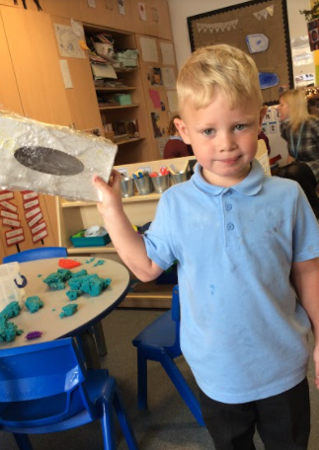
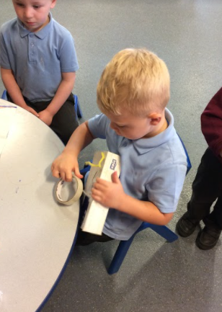

Slide 19
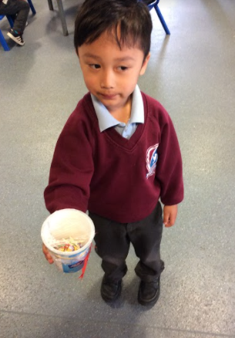
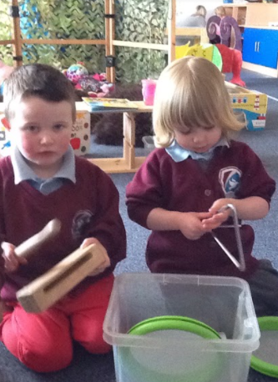

Slide 20
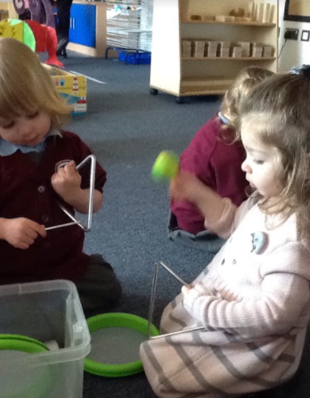
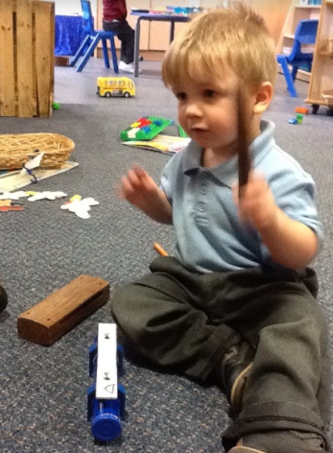
https://drive.google.com/file/d/1uyh3fSererJVwpLRSY_up88rUnDYjjLw/view?usp=sharing

Slide 23
